Slide 1
8085 Architecture & Its Assembly language programming

Slide 2
Outline
8085 Era and Features
8085
Block diagram (Data Path)
Bus Structure
Register Structure
Instruction Set of 8085
Sample program of 8085

Slide 3
8085 Microprocessor
8 Bit CPU
3-6Mhz
Simpler design
ISA = Pre x86 design (Semi CISC)
40 Pin Dual line Package
16 bit address
6 registers: B, C, D, E, H,L
Accumulator 8 bit

Slide 4
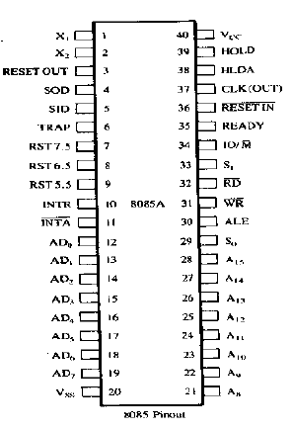
Pin-diagram

Slide 5
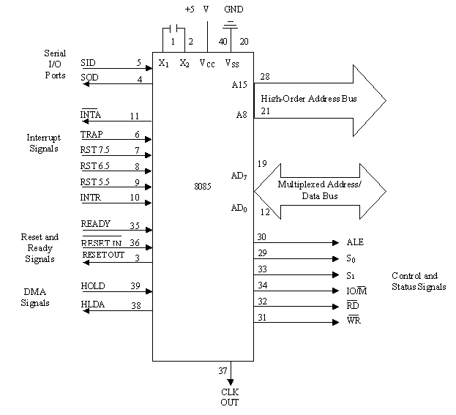
Functional block diagram

Slide 6
8085 Microprocessor Architecture
RST6.5
INTR
INTA
RST5.5
RST7.5
TRAP
SID
SOD
Interrupt Control
Serial I/O Control
Bus 8 Bit
ACC
tmp R
MUX
IR
W
Z
B
C
Flag
D
E
I Decode
&
M/C
Encoding
ALU
H
L
SP
PC
Inc/Dec. ter
Add latch
Timing and Control
Add Buff
Data/Add Buff
Notes:
<number>

Slide 7
The 8085 Bus Structure
8085
MPU
A₁₅
Address Bus (16bit)
A₀
Memory
I/P
O/P
_{D7}
Data Bus (8bit)
_{D0}
Control Bus (8bit)
Notes:
<number>

Slide 8
8085 Bus Structure
Address Bus : Consists of 16 address lines: A₀ – A₁₅
Address locations: 0000 (hex) – FFFF (hex)
Can access 64K ( = 2¹⁶ ) bytes of memory, each byte has 8 bits
Can access 64K × 8 bits of memory
Use memory to map I/O, Same instructions to use for accessing I/O devices and memory
Data Bus : Consists of 8 data lines: D₀ – D₇
Operates in bidirectional mode
The data bits are sent from the MPU to I/O & vice versa
Data range: 00 (hex) – FF (hex)
Control Bus:

Slide 9
8085 Registers
Registers:
Six general purpose 8-bit registers: B, C, D, E, H,L
Combined as register pairs to perform 16-bit operations: BC, DE, HL
Registers are programmable (load, move, etc.)
Stack Pointer (SP)
Accumulator & Flag Register
(Zero, Sign, Carry, Parity, AuxCarry)
Program Counter (PC)
Contains the memory address (16 bits) of the instruction that will be executed in the next step.
B
C
D
E
H
L
SP
PC

Slide 10
Register Addressing
The most common form of data addressing.
once register names learned, easiest to apply.
The microprocessor contains these 8-bit register names used with register addressing: AH, AL, BH, BL, CH, CL, DH, and DL.

Slide 11
In 80386 & above, extended 32-bit register names are: EAX, EBX, ECX, EDX, ESP, EBP, EDI, and ESI.
64-bit mode register names are: RAX, RBX, RCX, RDX, RSP, RBP, RDI, RSI, and R8 through R15.
Important for instructions to use registers that are the same size.
never mix an 8-bit with a 16-bit register, an 8- or a 16-bit register with a 32-bit register

Slide 12
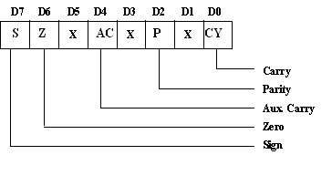
Flag Register

Slide 13
Status Signals
IO/M | S1 | S0 | OPERATION
0 | 1 | 1 | Opcode fetch
0 | 1 | 0 | Memory read
0 | 0 | 1 | Memory write
1 | 1 | 0 | I/O read
1 | 0 | 1 | I/O write
1 | 1 | 0 | Interrupt acknowledge
Z | 0 | 1 | Halt
Z | x | x | Hold
Z | x | x | Reset

Slide 14
Reset Signal
RESET IN : When this signal goes low,
the program counter (PC) is set to Zero,
μp is reset
The data and address buses and the control lines are 3-stated during RESET
The CPU is held in the reset condition as long as RESET- IN is applied
RESET OUT: This signal indicates that μp is being reset.
This signal can be used to reset other devices.
The signal is synchronized to the processor clock and lasts an integral number of clock periods.
.

Slide 15
Serial communication
Serial communication Signal
SID - Serial Input Data Line: The data on this line is loaded into accumulator bit 7 whenever a RIM instruction is executed.
SOD – Serial Output Data Line: The SIM instruction loads the value of bit 7 of the accumulator into SOD latch if bit 6 (SOE) of the accumulator is 1.

Slide 16
DMA Signals
HOLD: Indicates that another master is requesting the use of the address and data buses.
The CPU, upon receiving the hold request, will relinquish the use of the bus as soon as the completion of the current bus transfer.
Internal processing can continue. The processor can regain the bus only after the HOLD is removed.
When the HOLD is acknowledged, the Address, Data RD, WR and IO/M lines are 3-stated.
HLDA: Hold Acknowledge: Indicates that the CPU has received the HOLD request and that it will relinquish the bus in the next clock cycle.
HLDA goes low after the Hold request is removed. The CPU takes the bus one half-clock cycle after HLDA goes low.

Slide 17
Ready Signal
READY: This signal Synchronizes the fast CPU and the slow memory, peripherals.
If READY is high during a read or write cycle, it indicates that the memory or peripheral is ready to send or receive data.
If READY is low, the CPU will wait an integral number of clock cycle for READY to go high before completing the read or write cycle.
READY must conform to specified setup and hold times.

Slide 18
Interrupts
8085 has 5 interrupts priority (from lowest to highest):
INTR: (maskable and non-vectored interrupt). When the interrupt occurs, the processor fetches from the bus one instruction, usually one of these instructions:
One of the 8 RST instructions (RST0 - RST7). The processor saves current program counter into stack and branches to memory location N * 8 (where N is a 3-bit number from 0 to 7 supplied with the RST instruction).
CALL: (3 byte instruction). The processor calls the subroutine, address of which is specified in the second and third bytes of the instruction.
RST5.5: (maskable interrupt). When this interrupt is received the processor saves the contents of the PC register into stack and branches to 2CH address.
RST6.5: (maskable interrupt) When this interrupt is received the processor saves the contents of the PC register into stack and branches to 34H address
RST7.5 (maskable interrupt) When this interrupt is received the processor saves the contents of the PC register into stack and branches to 3CH (hexadecimal) address
TRAP: (non-maskable interrupt) When this interrupt is received the processor saves the contents of the PC register into stack and branches to 24H address.
All maskable interrupts can be enabled or disabled using EI and DI instructions. RST 5.5, RST6.5 and RST7.5 interrupts can be enabled or disabled individually using SIM instruction
Notes:
INTR is maskable using the EI/DI instruction pair
The vectors for these interrupt fall in between the
vectors for the RST instructions. That’s why they
have names like RST 5.5 (RST 5 and a half)
<number>

Slide 19
8085 Non-Vectored Interrupt Process
The interrupt process should be enabled using the EI instruction.
The 8085 checks for an interrupt during the execution of every instruction.
If INTR is high, Processor completes current instruction, disables the interrupt and sends INTA (Interrupt acknowledge) signal to the device that interrupted
INTA allows the I/O device to send a RST instruction through data bus.
MP saves the memory location of the next instruction, on the stack and the program is transferred to ‘call’ location (ISR Call) specified by the RST instruction
Microprocessor Performs the ISR. ISR must include the ‘EI’ instruction to enable the further interrupt within the program.
RET instruction at the end of the ISR allows the MP to retrieve the return address from the stack and the program is transferred back to where the program was interrupted.

Slide 20
Interrupt vectors
An interrupt vector is a pointer to where the ISR is stored in memory.
All interrupts (vectored or otherwise) are mapped onto a memory area called the Interrupt Vector Table(IVT).
The IVT is usually located in memory page 00 (0000H - 00FFH).
Example:
Let a device interrupts the Microprocessor using the RST 7.5 interrupt line.
Because the RST 7.5 interrupt is vectored, Microprocessor knows in which memory location it has to go using a call instruction to get the ISR address.
RST7.5 is known as Call 003Ch to Microprocessor. Microprocessor goes to 003C location and will get a JMP instruction to the actual ISR address. The microprocessor will then, jump to the ISR location

Slide 21
Vectored Interrupt
The interrupt process should be enabled using the EI instruction.
The 8085 checks for an interrupt during the execution of every instruction.
If there is an interrupt, and if the interrupt is enabled using the interrupt mask, the microprocessor will complete the executing instruction, and reset the interrupt flip flop.
The microprocessor then executes a call instruction that sends the execution to the appropriate location in the interrupt vector table.
When the microprocessor executes the call instruction, it saves the address of the next instruction on the stack.
The microprocessor jumps to the specific service routine.
The service routine must include the instruction EI to re-enable the interrupt process.
At the end of the service routine, the RET instruction returns the execution to where the program was interrupted.

Slide 22
MANIPULATING THE MASKS
MANIPULATING THE MASKS
The Interrupt Enable flip flop is manipulated using the EI/DI instructions.
The individual masks for RST 5.5, RST 6.5 and RST 7.5 are manipulated using the SIM instruction.
The SIM instruction takes the bit pattern in the Accumulator and applies it to the interrupt mask enabling and disabling the specific interrupts.

Slide 23
How SIM Interprets the Accumulator
7
6
5
4
3
2
1
0
M7.5
M5.5
SDO
MSE
M6.5
SDE
R7.5
XXX
RST5.5 Mask
}
Serial Data Out
RST6.5 Mask
0 - Available
1 - Masked
RST7.5 Mask
Enable Serial Data
0 - Ignore bit 7
1 - Send bit 7 to SOD pin
Mask Set Enable
0 - Ignore bits 0-2
1 - Set the masks according
to bits 0-2
Not Used
Force RST7.5 Flip Flop to reset
If MSE is 1
If the mask bit is 0, the interrupt is available.
If the mask bit is 1, the interrupt is masked.
<number>

Slide 24
How RIM sets the Accumulator’s different bits
7
6
5
4
3
2
1
0
M7.5
M5.5
SDI
P6.5
IE
M6.5
P7.5
P5.5
RST5.5 Mask
}
Serial Data In
RST6.5 Mask
0 - Available
1 - Masked
RST7.5 Mask
RST5.5 Interrupt Pending
RST6.5 Interrupt Pending
RST7.5 Interrupt Pending
Interrupt Enable
Value of the Interrupt Enable
Flip Flop

Slide 25
Determining the Current Mask Settings
RIM instruction: Read Interrupt Mask
Load the accumulator with an 8-bit pattern showing the status of each interrupt pin and mask.
RST7.5 Memory
RST 7.5
M 7.5
7
6
5
4
3
2
1
0
SDI
M7.5
M5.5
P7.5
IE
M6.5
P6.5
P5.5
RST 6.5
M 6.5
RST 5.5
M 5.5
Interrupt Enable
Flip Flop
<number>

Slide 26
What is Memory Mapped I/O?
Instead of having special methods for accessing the values to be read or written, just get them from memory or put them into memory.
The device is connected directly to certain main memory locations.
Two types of information to/from the device
Status
Value read/write

Slide 27
Memory Mapped I/O
CPU
Address
Data
7
0
Main memory
Data register
(address = 5000)
7
0
Ready
IF
…
IE
Status register
(address = 5002)
Keyboard controller

Slide 28
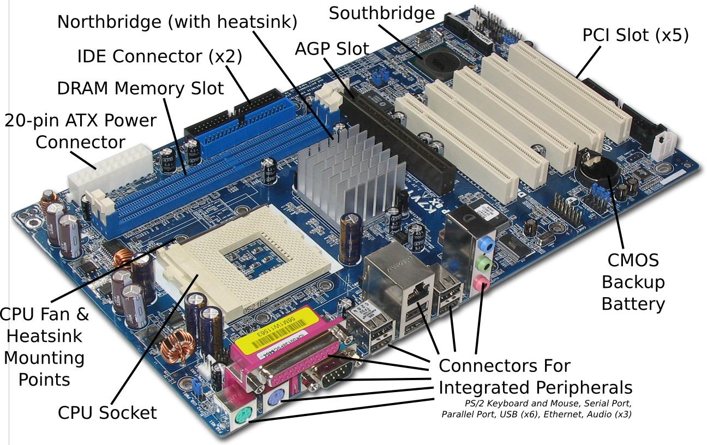
Mother Board

Slide 29
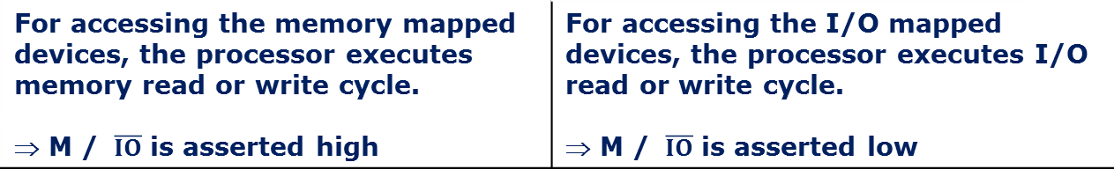
comparison
Memory mapping | I/O mapping
16/20 bit address are provided for I/O devices | 8-bit or 16-bit addresses are provided for I/O devices
The I/O ports or peripherals can be treated like memory locations and so all instructions related to memory can be used for data transmission between I/O device and processor | Only IN and OUT instructions can be used for data transfer between I/O device and processor
Data can be moved from any register to ports and vice versa | Data transfer takes place only between accumulator and ports
When memory mapping is used for I/O devices, full memory address space cannot be used for addressing memory. ⇒ Useful only for small systems where memory requirement is less | Full memory space can be used for addressing memory. ⇒ Suitable for systems which require large memory capacity
For accessing the memory mapped devices, the processor executes memory read or write cycle. ⇒ M / is asserted high | For accessing the I/O mapped devices, the processor executes I/O read or write cycle. ⇒ M / is asserted low
28
Notes:
<number>

Slide 30
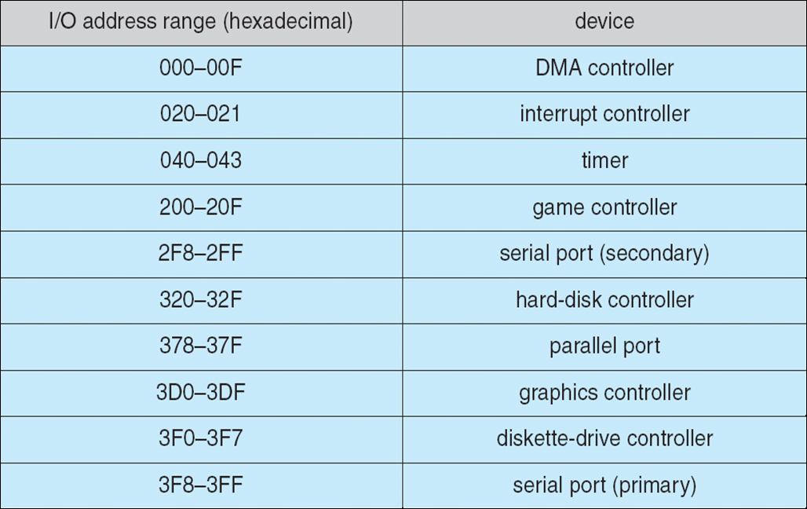
IO Mapped IO Device I/O Port Locations on PCs (partial)
Notes:
<number>

Slide 31
Instruction format
Based on word size(8-bit processor so byte is same as word)
One byte instruction
Ex.: Mov rd,rs
Binary code: 01 ddd sss
Mov A,B: 01 111 000 = 78h
Two byte instruction
Ex.: mvi A, data
Binary code: 0011 1110 data
Mvi A, 30: 3E 30h
Three byte instruction
Ex.: Lxi rp,data_address //rp: register pair
Binary code: 21 lower_byte upper byte address
Lxi H, 2236: 21 36 22 h

Slide 32
MACHINE CYCLE
The 8085 CPU can perform seven basic machine operations. All but the bus-idle cycle involve the transfer of data between the CPU and a peripheral device.
The seven machine cycles are :
Opcode Fetch fetch the opcode of an instruction from memory
Memory Read read data stored at an addressed memory location
Memory Write write data to an addressed memory location
IO Read read data from an addressed input device
IO Write write data to an addressed output device
Interrupt Ack acknowledge an interrupt request
Bus Idle no bus operation

Slide 33
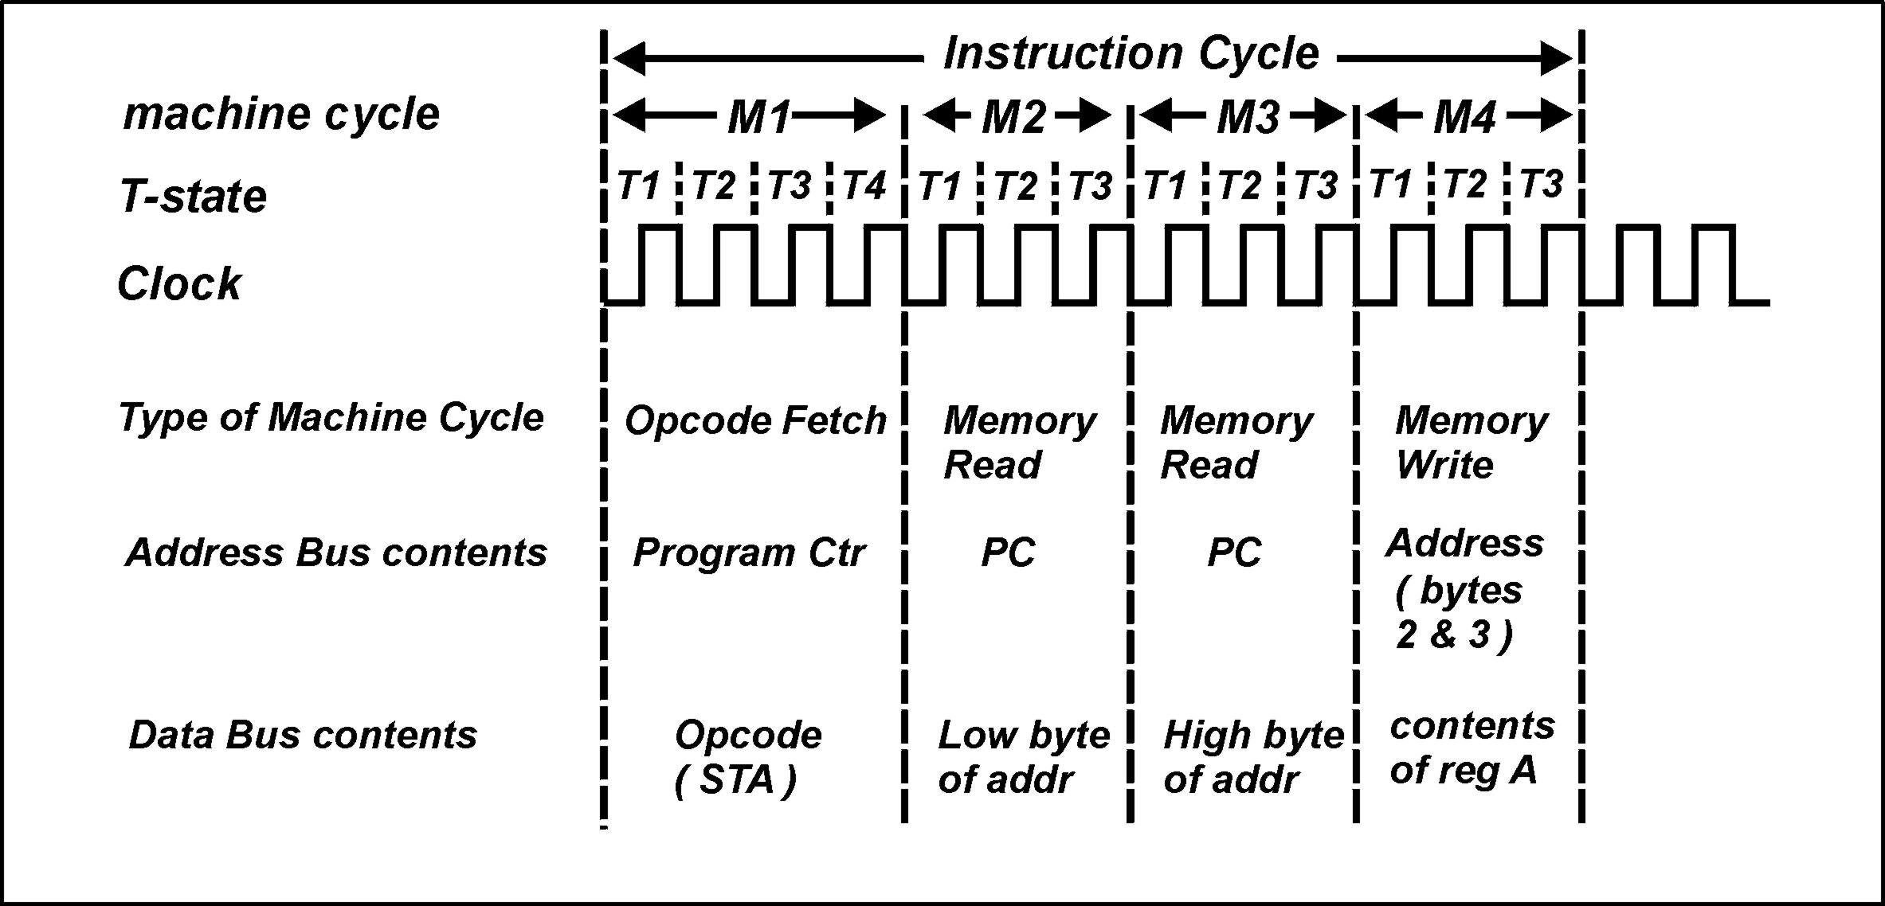
MACHINE CYCLE
Example instruction: STA addr

Slide 34
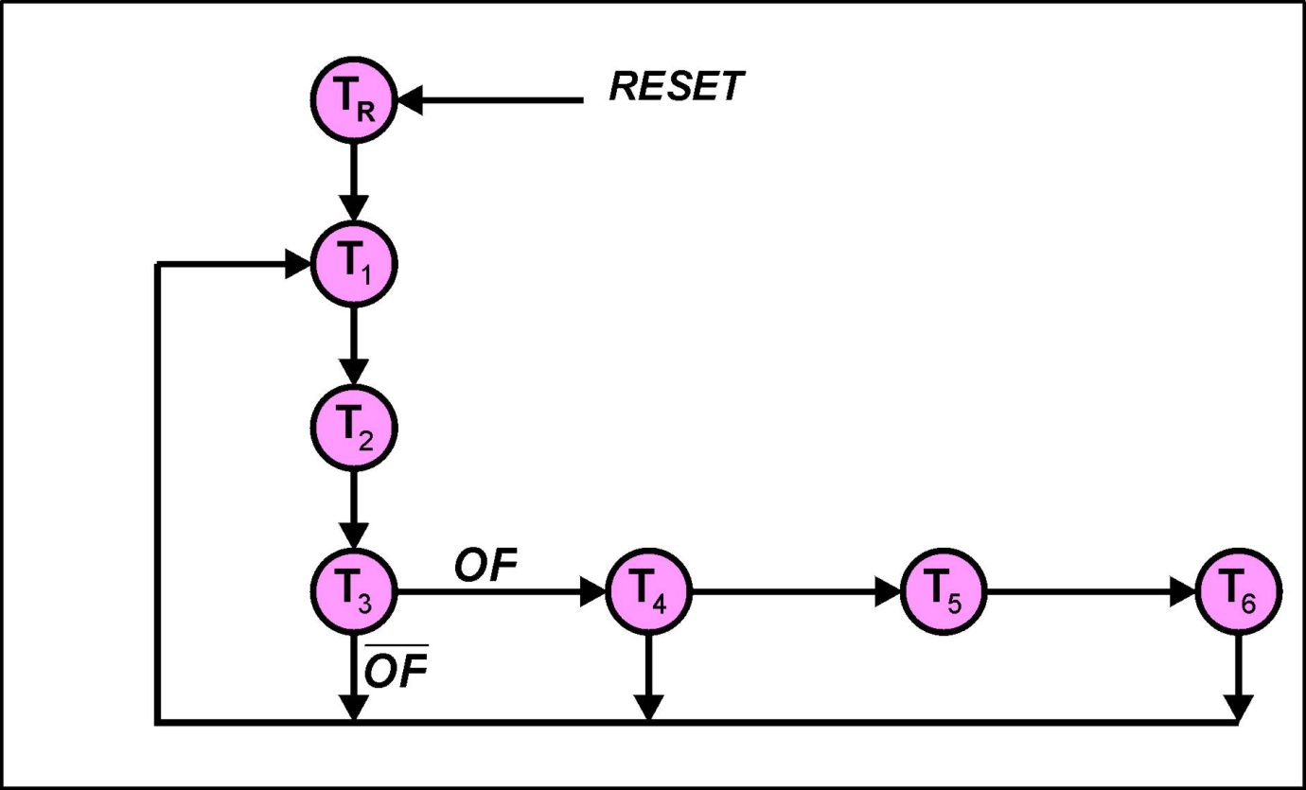
T-STATE
The operation of the 8085 can be described with respect to its state diagram ( it is a synchronous state machine )

Slide 35
MACHINE CYCLE
Opcode Fetch
The first operation in every instruction
Retrieves the opcode of the instruction that is being executed
Usually composed 4 clock cycles (T-state)
Some instruction required 6 T-state (CALL, INX, DCX)
IO/M signal is low (indicating a memory operation)

Slide 36
MACHINE CYCLE
Memory Read
Machine cycle during which memory is read
Composed 3 clock cycles
IO/M signal is low (indicating a memory operation)
Memory Write
This machine cycle is used when the 8085 needs to send data out from the accumulator or a specific register and then write it into memory
Composed 3 clock cycles
IO/M signal is low (indicating a memory operation)

Slide 37
MACHINE CYCLE
I/O Read
Indicates that data is being read from an I/O device
Occurs when IN instruction is executed
Composed 3 clock cycles
IO/M signal is high (indicating an I/O operation)
I/O Write
This machine cycle is used to write data out from accumulator in the microprocessor to the I/O device specified by the port address
Occurs when OUT instruction is executed
Composed 3 clock cycles
IO/M signal is high (indicating an I/O operation)

Slide 38
MACHINE CYCLE
Interrupt Acknowledge
Special machine cycle that is used to place of the opcode fetch cycle in the RST (restart) instruction.
Similar to opcode fecth instruction except that it send out INTA signal instead of RD signal and IO/M signal is High
Composed 6 clock cycle

Slide 39
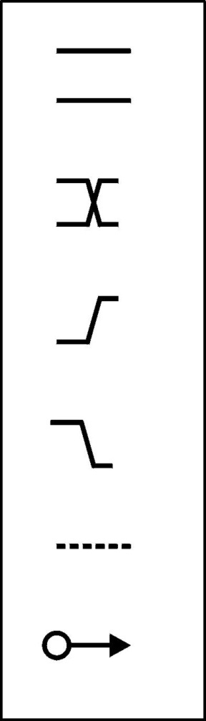
T-STATE
Key to timing diagram
Indicates a bus. Whilst the lines remain parallel the
individual bits of the bus remain unchanged.
Indicates a bus. Where the lines cross indicates a possible change in logic level of one or more bits of the bus.
Indicates a 0 -> 1 transition of a digital signal
Indicates a 1 -> 0 transition of a digital signal
Indicates a bus or a bit being in the Hi-Z state ( tri-state )
The tail of the arrow indicates the cause of a signal change.
The head of the arrow indicates the affected signal.

Slide 40
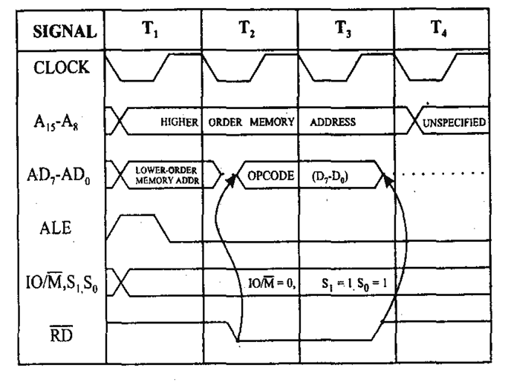
Opcode Fetch

Slide 41
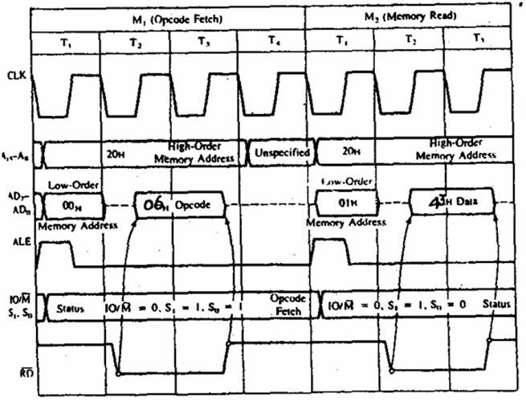
MVI

Slide 42
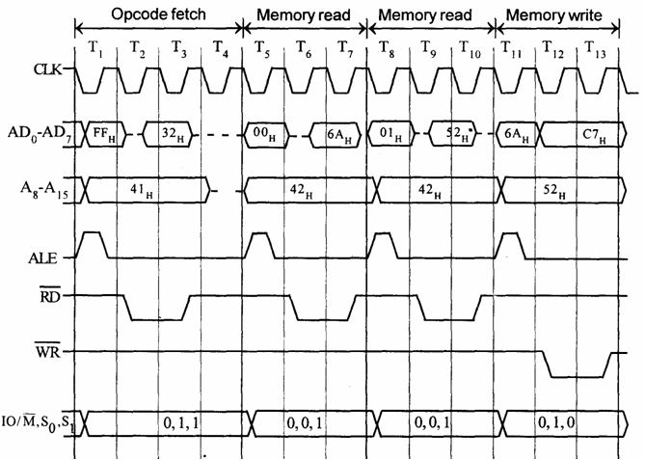
STA 526A (32, 6A, 52 ( ACC-C7)

Slide 43
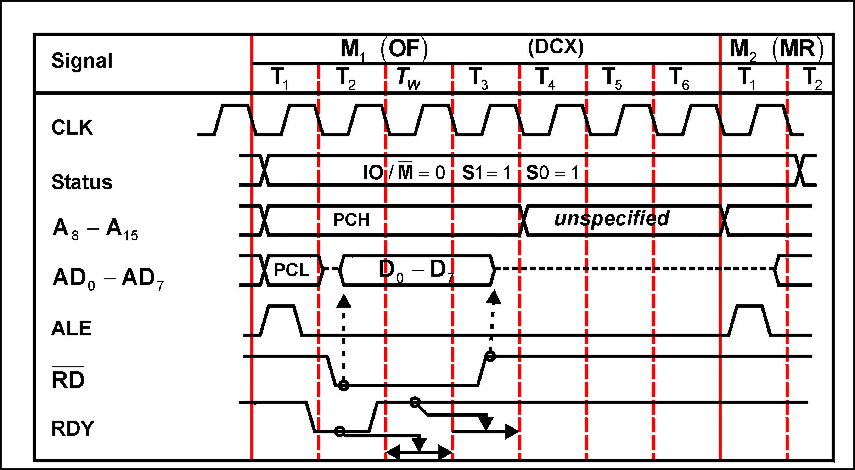
Wait-State

Slide 44
Instruction Set & Addressing mode
Instruction Set:
8085 instruction set consists of the following instructions:
Data moving instructions.
Arithmetic - add, subtract, increment and decrement.
Logic - AND, OR, XOR and rotate.
Control transfer - conditional, unconditional, call subroutine, return from subroutine and restarts.
Input/Output instructions.
Other - setting/clearing flag bits, enabling/disabling interrupts, stack operations, etc.
Addressing mode
Register - references the data in a register or in a register pair.
Register indirect - instruction specifies register pair containing address, where the data is located.
Direct,
Immediate - 8 or 16-bit data

Slide 45
8085 Microprocessor Memory
Memory:
Program, data and stack memories occupy the same memory space. The total addressable memory size is 64KB.
Program memory - program can be located anywhere in memory.
Jump, branch and call instructions use 16-bit addresses, i.e. they can be used to jump/branch anywhere within 64 KB.
All jump/ branch instructions use absolute addressing.
Data memory - the processor always uses 16-bit addresses so that data can be placed anywhere.
Stack memory is limited only by the size of memory. Stack grows downward.
First 64 bytes in a zero memory page should be reserved for vectors used by RST instructions
Notes:
First 64 bytes in a zero memory page should be reserved for vectors used by RST instructions
<number>

Slide 46
8085 MP Instruction Set Architecture
Contains several registers include B,C,D,E,H,L and an 8-bit accumulator register, A.
The registers B,C,D,E,H,L can be accessed as pairs. Pairs are not arbitrary. B and C, D and E, H and L.
SP is a 16 bit stack pointer register pointing to the top of the stack.
PC is a 16-bit Program counter
Contains five flags known as flag registers:
Notes:
Parity flag, P, is set to 1 if result contains even number of 1’s
Auxiliary carry flag, generates a carry out from a lower half of a result to a upper half.
Example:
0000 1111 + 0000 1000 = 0001 0111
<number>

Slide 47
Instruction Set of 8085
Arithmetic Operations
add, sub, inr/dcr
Logical operation
and, or, xor, rotate, compare, complement
Branch operation
Jump, call, return
Data transfer/Copy/Memory operation/IO

Slide 48
Copy/Mem/IO operation
MVI R, 8 bit // load immediate data
MOV R1, R2 // Example MOV B, A
MOV R M // Copy to R from 0(HL Reg) Mem
MOV M R // Copy from R to 0(HL Reg) Mem
LDA 16 bit // load A from 0(16bit)
STA 16 bit // Store A to 0(16bit)
LDAX Rp // load A from 0(Rp), Rp=RegPair
STAX Rp // Store A to 0(Rp)
LXI Rp 16bit // load immediate to Rp
IN 8bit // Accept data to A from port 0(8bit)
OUT 8 bit

Slide 49
Arithmetic Operation
ADD R // Add A = A + B.reg
ADI 8bit // Add A= A + 8bit
ADD M // Add A=A + 0(HL)
SUB R // Sub A = A -B.reg
SUI 8bit // Sub A= A - 8bit
SUB M // Sub A=A - 0(HL)
INR R // R = R+1
INR M // 0(HL)=0(HL)+1
DCR R // R = R-1
DCR M // 0(HL)=0(HL)-1
INX Rp // Rp=Rp+1
DCX Rp // Rp

Slide 50
Other Operations
Logic operations
ANA R ANI 8bit ANA M
ORA, ORI, XRA, XRI
CMP R // compare with R with ACC
CPI 8bit // compare 8 bit with ACC
Branch operations
JMP 16bit, CALL 16 bit
JZ 16bit, JNZ 16bit, JC 16bit, JNC 16 bit
RET
Machine Control operations

Slide 51
8085 Microprocessor Instruction Set
Contains a total of 74 different instructions.
R, R1, R2 | 8 bit registers representing A, B, C, D, E, H or L
M | Indicates memory location
RP | Indicates register pair such as BC, DE, HL, SP
Γ | 16 bit address representing address or data value.
n | 8-bit address or data value stored in memory immediately after the opcode
Cond | Condition for conditional instructions. NZ (Z = 0), Z (Z = 1),P (S = 0), N (S = 1), PO (P = 0), PE (P = 1), NC (CY = 0), C (CY=1)

Slide 52
Data movement instruction for the 8085 microprocessor
Instruction | Operation
NOP | No operation
MOV r1, r2 | r1 = r2
MOV r, M | r1 = M[HL]
MOV M, r | M[HL] = r
MVI r, n | r = n
MVI M, n | M[HL] = n
LXI rp, Γ | rp = Γ
LDA Γ | A = M[Γ]
STA Γ | M[Γ] = A
LHLD Γ | HL = M[Γ], M[Γ + 1]
SHLD Γ | M[Γ], M[Γ + 1] = HL
LDAX rp | A = M[rp] (rp = BC, DE)
STAX rp | M[rp] = A (rp = BC, DE)
XCHG | DE ↔ HL
PUSH rp | Stack = rp (rp ≠ SP)
PUSH PSW | Stack = A, flag register
POP rp | rp = Stack (rp ≠ SP)
POP PSW | A, flag register = Stack
XTHL | HL ↔ Stack
SPHL | SP = HL
IN n | A = input port n
OUT n | Output port n = A

Slide 53
Data operation instruction for the 8085 microprocessor
Instruction | Operation | Flags
ADD r | A = A + r | All
ADD M | A = A + M[HL] | All
ADI n | A = A + n | All
ADC r | A = A + r + CY | All
ADC M | A = A + M[HL] + CY | All
ACI n | A = A + n + CY | All
SUB r | A = A - r | All
SUB M | A = A - M[HL] | All
SUI n | A = A - n | All
SBB r | A = A - r - CY | All
SBB M | A = A - M[HL] - CY | All
SBI n | A = A - n - CY | All
INR r | r = r + 1 | Not CY
INR M | M[HL] = M[HL] + 1 | Not CY
DCR r | r = r - 1 | Not CY
DCR M | M[HL] = M[HL] - 1 | Not CY
INX rp | rp = rp + 1 | None
DCX rp | rp = rp - 1 | None
DAD rp | HL = HL + rp | CY
DAA | Decimal adjust | All
ANA r | A = A ∧ r | All
ANA M | A = A ∧ M[HL] | All

Slide 54
Data operation instruction for the 8085 microprocessor
Instruction | Operation | Flags
ANI n | A = A ∧ n | All
ORA r | A = A ∨ r | All
ORA M | A = A ∨ M[HL] | All
ORI n | A = A ∨ n | All
XRA r | A = A ⊕ r | All
XRA M | A = A ⊕ M[HL] | All
XRI n | A = A ⊕ n | All
CMP r | Compare A and r | All
CMP M | Compare A and M[HL] | All
CPI n | Compare A and n | All
RLC | CY = A7, A = A(6-0), A7 | CY
RRC | CY = A0, A = A0, A(7-1) | CY
RAL | CY, A = A, CY | CY
RAR | A, CY = CY, A | CY
CMA | A = A’ | None
CMC | CY = CY’ | CY
STC | CY = 1 | CY

Slide 55
Program control instruction
Instruction | Operation
JUMP Γ | GOTO Γ
J cond Γ | If condition is true then GOTO Γ
PCHL | GOTO address HL
CALL Γ | Call subroutine at Γ
C cond Γ | If condition is true then call subroutine at Γ
RET | Return from subroutine
R cond | If condition is true then return from subroutine
RST n | Call subroutine at 8*n (n = 5.5, 6.5, 7.5)
RIM | A = IM
SIM | IM = A
DI | Disable interrupts
EI | Enable interrupts
HLT | Halt the CPU

Slide 56
A Simple 8085 Program
1: i = n, sum = 0
2: sum = sum + i, i = i - 1
3: IF i ≠ 0 then GOTO 2
4: total = sum

Slide 57
A Simple 8085 Program (contd)
LDA n
MOV B, A
XRA A
Loop: ADD B
DCR B
JNZ Loop
STA total
i = n
sum = A ⊕ A = 0
sum = sum + i
i = i - 1
IF i ≠ 0 THEN GOTO Loop
total = sum

Slide 58
Execution trace
Instruction | 1st Loop | 2nd Loop | 3rd Loop | 4th Loop | 5th Loop
LDA n MOV B, A | B = 5
XRA A | A = 0
ADD B | A = 5 | A = 9 | A = 12 | A = 14 | A = 15
DCR B | B = 4, Z = 0 | B = 3, Z = 0 | B = 2, Z = 0 | B = 1, Z = 0 | B = 0, Z = 1
JNZ Loop | JUMP | JUMP | JUMP | JUMP | NO JUMP
STA total |  |  |  |  | total = 15

Slide 59
Simple Assembly Program
MVI A, 24H // load Reg ACC with 24H
MVI B , 56H // load Reg B with 56H
ADD B // ACC= ACC+B
OUT 01H // Display ACC contents on port 01H
HALT // End the program
Result: 7A (All are in Hex)

Slide 60
Code to multiply two number
LDA 2000 // Load multiplicant to accumulator
MOV B,A // Move multiplicant from A(acc) to B register
LDA 2001 // Load multiplier to accumulator
MOV C,A // Move multiplier from A to C
MVI A,00 // Load immediate value 00 to a
L: ADD B // Add B(multiplier) with A
DCR C // Decrement C, it act as a counter
JNZ L // Jump to L if C reaches 0
STA 2010 // Store result in to memory
HLT // End

Slide 61
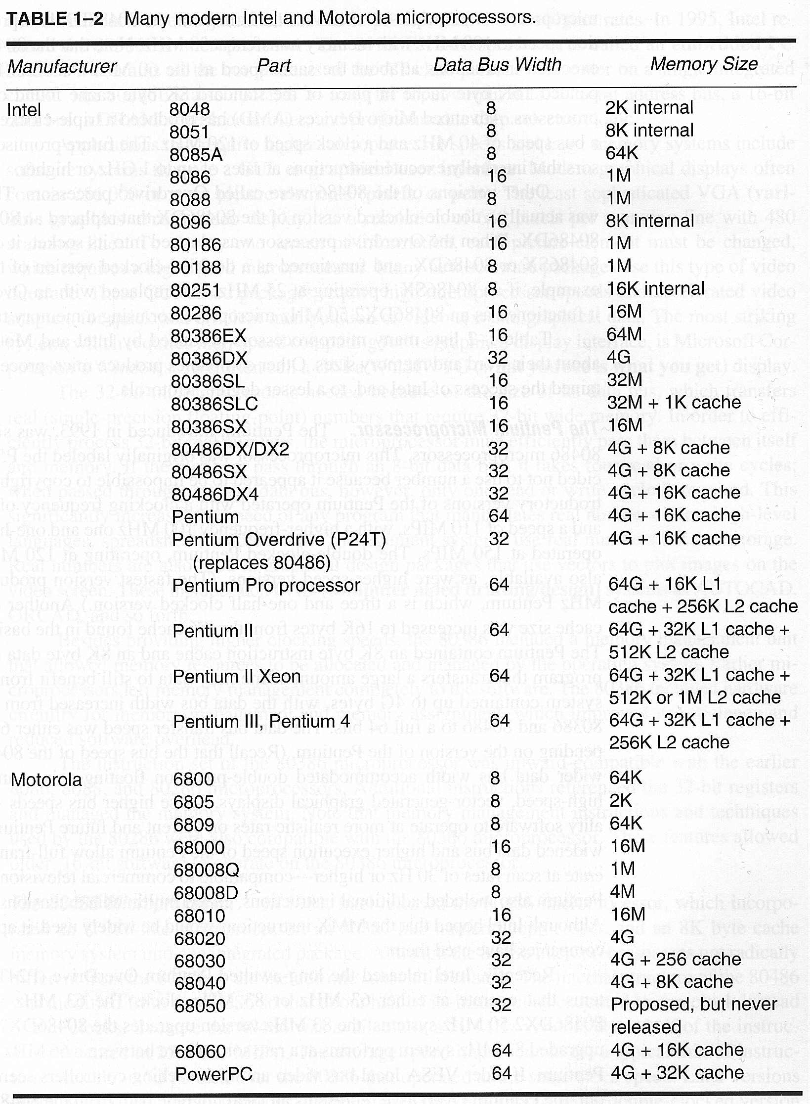
|
|
|
|
|
|
<number>

Slide 62
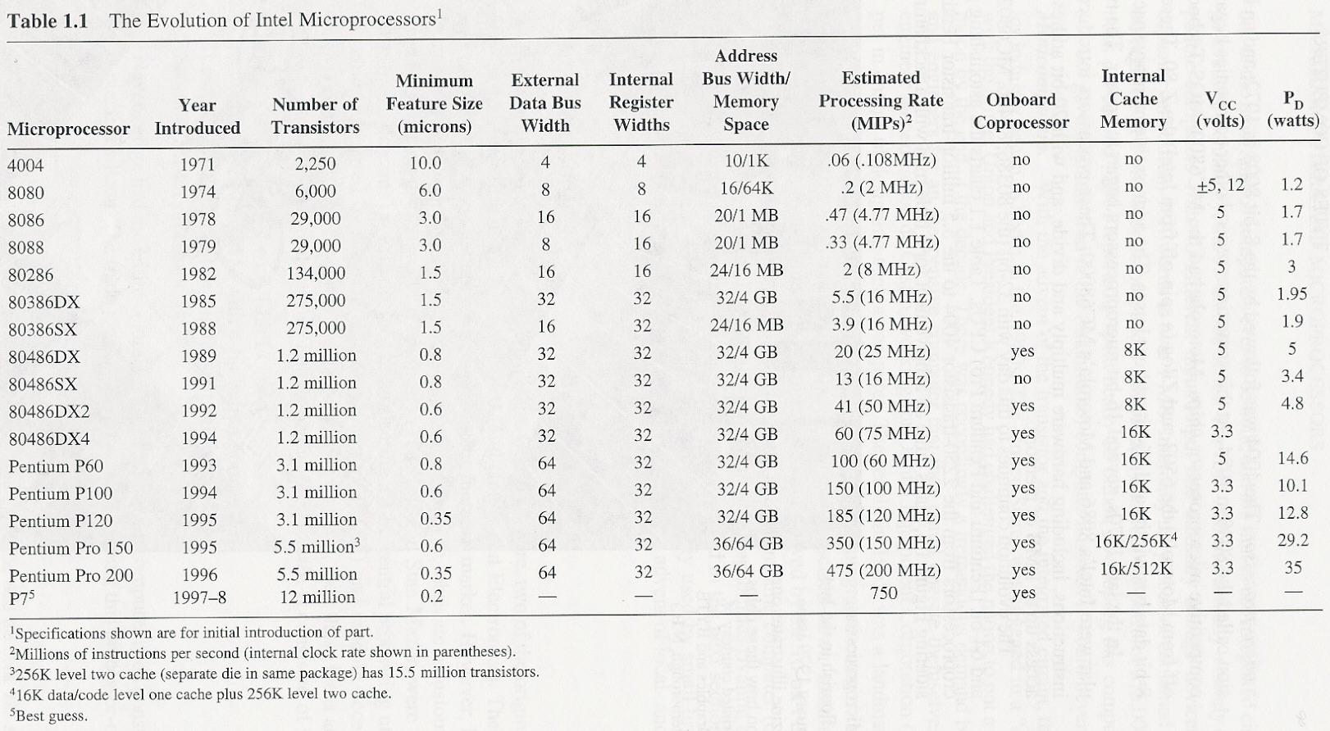
<number>

Slide 63
Next…
8086
Block diagram (Data Path), Registers
Memory Model
Stack, Data and Code Segment
Instruction Set of x86
Addressing mode
Procedure and subroutine
Examples programs in C/C++ assembly
Peripheral device and Assembly program

Slide 64
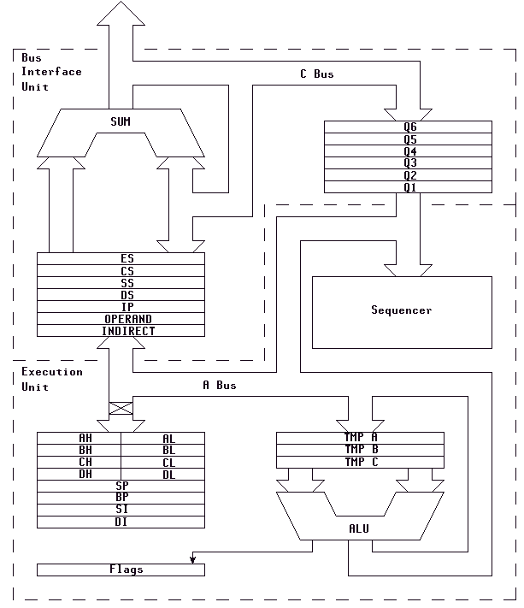
8086 Architecture
Bus Interface Unit
C BUS
SUM
Q6
Q5
Q4
Q3
Q2
Q1
CS (Code Seg Reg)
DS (Data Seg Reg )
ES (Extra Seg Reg )
Sequencer
SS (Stack Seg Reg)
IP (Intr Ptr)
Operand
InDirect
Execution
Unit
A BUS
AH
AL
Temp A
BH
BL
Temp B
CH
CL
Temp C
DH
DL
SI (Source Idx )
DI (Dest. Idx)
BP (Base Ptr )
ALU
SP (Stack Ptr)
Z (Flag Reg)

Slide 65
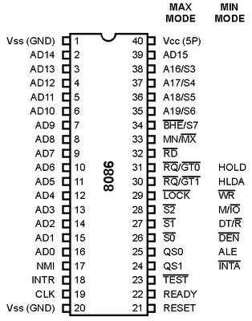
Minimum/Max Mode Configuration For 8086
The microprocessor 8086 is operated in minimum mode by strapping its MN/MX pin to logic 1.
In this mode, all the control signals are given out by the microprocessor chip itself. There is a single microprocessor in the minimum mode system.
In the maximum mode, the 8086 is operated by strapping the MN/MX pin to ground.
In the maximum mode, there may be more than one
microprocessor in the system configuration. The components in the system are same as in the minimum mode system.

Slide 66
8086 & x86 Registers
31 15 7 0
AX - accumulator reg
BX - base address reg
CX - count reg
DX - data reg
SI - source index reg
DI - dest index reg
BP - base pointer.
SP - stack pointer.
EAX
AH
AL
EBX
BH
BL
ECX
CH
CL
EDX
DH
DL
ESI
SI (Source Idx )
EDI
DI (Dest. Idx)
EBP
BP (Base Ptr )
ESP
SP (Stack Ptr)
EZ
Z (Flag Reg)
ECS
CS (Code Seg Reg)
EDS
DS (Data Seg Reg )
EES
ES (Extra Seg Reg )
ESS
SS (Stack Seg Reg)
EIP
IP (Intr Ptr)

Slide 67
Memory layout of C program
int A;
int B=10;
main(){
int Alocal;
int *p;
p=(int*)malloc(10);
Stack
Heap
Data
BSS
Code

Slide 68
Memory layout of C program
Stack
automatic (default), local
Initialized/uninitialized
Data
Global, static, extern
BSS: Block Started by Symbol
Code
program instructions
Heap
malloc, calloc
Stack
Heap
Data
BSS
Code

Slide 69
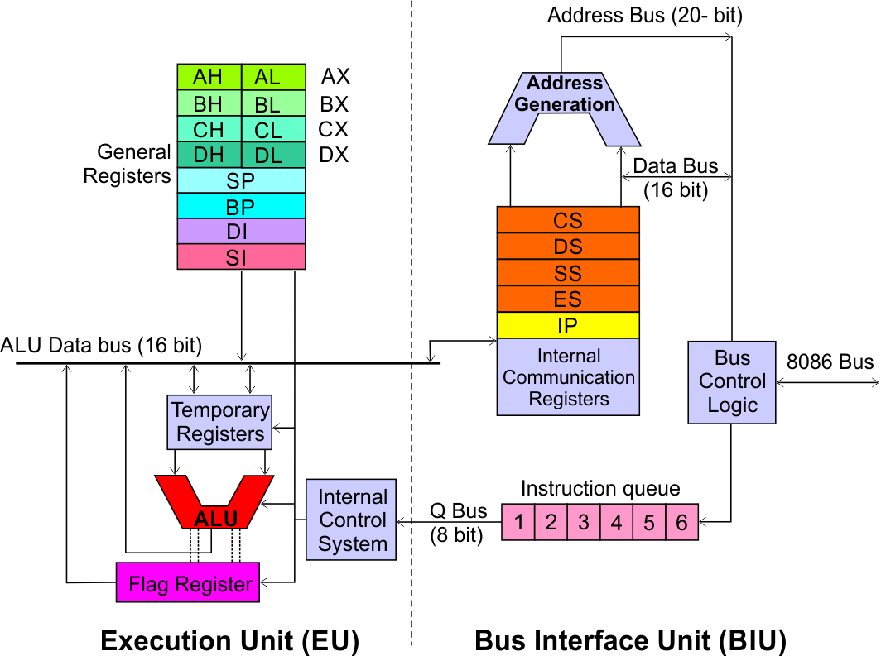
8086 Microprocessor
Architecture
Execution Unit (EU)
EU executes instructions that have already been fetched by the BIU.
BIU and EU functions separately.
Bus Interface Unit (BIU)
BIU fetches instructions, reads data from memory and I/O ports, writes data to memory and I/ O ports.
69
Notes:
<number>

Slide 70
Main Memory
Code and Data
segments are separate
and both assumed
to start from 0
if (j>k)
max = j
else
max = k
Code_Segment:
mov AX, [0]
mov BX, [2]
cmp AX,BX
jle 0x7 //Label_1
mov [4], AX
jmp 0x5 //Label_2
Label_1: mov [4], BX
Label_2: ….
0000
Operating System
(Kernel)
0700
Other User
Process
Every Memory Data
Access should add
the value stored in
Data Segment Register
By default.
0900
Our Code
Segment
Segment Register (Data)
1900
Data Segment:
0: // Allocated for j
2: // Allocated for k
4: // Allocated for max
2100
Vacant
Space
Address of j: 2100
Address of k: 2102
Address of max: 2104
2100
Our Data
Segment
2300
Vacant
Space
Ease Of Programming
2500

Slide 71
Main Memory
if (j>k)
max = j
else
max = k
Code_Segment:
mov AX, [0]
mov BX, [4]
cmp AX,BX
jle 0x7 //Label_1
mov [4], AX
jmp 0x5 //Label_2
Label_1: mov [4], BX
Label_2: ….
0000
Operating System
(Kernel)
0700
Other User
Process
A new process needs a
segment of size 260
The space is available
but not contiguous
0900
Our Code
Segment
Segment Register (Data)
1900
Data Segment:
0: // Allocated for j
2: // Allocated for k
4: // Allocated for max
2100
Address of j: 2100
Address of k: 2102
Address of max: 2104
2300
Vacant
Space
New User
Process
2100
Our Data
Segment
2160
Vacant
Space
Vacant Space
2300
Address of j: 2300
Address of k: 2302
Address of max: 2304
Vacant
Space
Our Data
Segment
Process Mobility
2500

Slide 72
Multiple Segments
The segment register can change its values to point to different segments at different times.
X86 architecture provides additional segment registers to access multi data segments at the same time.
DS, ES, FS and GS
X86 supports a separate Stack Segment Register (SS) and a Code segment Register (CS) in addition.
By default a segment register is fixed for every instruction, for all the memory access performed by it. For eg. all data accessed by MOV instruction take DS as the default segment register.
An segment override prefix is attached to an instruction to change the segment register it uses for memory data access.

Slide 73
0000
mov [10], ax
- this will move the contents of ax register to memory location 0510
Opcode: 0x89 0x05 0x10
mov [ES:10], ax
this will move the contents of ax register to memory location 3510
Opcode
0x26 0x89 0x05 0x10
“0x26” is the segment override prefix.
DS
0500
1500
CS
SS
2500
3500
ES
Multiple Segments

Slide 74
Process 1
CS
CS
Process 1
DS
Process 1 in Execution
DS
Process 2
CS
Process 2
SS
SS
Process 2
DS
Process 2
in
Execution
Process 1
SS
Multiprocess Context switching

Slide 75
Three salient features of using Segmentation
Three Features
Code Mobility
Logically every segment can start with zero
Inter and Intra process protection ensuring data integrity.

Slide 76
Real Mode - Memory Addressing
Segment << 4 + offset = 20 bit EA
Segment size is a fixed 64K
mov [0x1000], AX
DS = 0x1004
The mov will store the content of AX in
0x10040 + 0x1000 = 0x11040
Why this stuff? - To get 1 MB addressing using 16-bit Segment Registers

Slide 77
A process always executes from Code segment. It should not execute by accessing from adjoining Data or stack area or any other code area too.
A stack should not overgrow into adjoining segments
CS
500
Every segment is specified a start address and limit.
Architecture checks if limit is not exceeded.
1000
ES
1500
SS
2000
mov [ES:499], AX //This is a violation!!!
jmp CS:501 //This is a violation as limit is 500
PUSH AX //Let SP be 499, violation
POP AX //Let SP be 0, Violation!!!
jmp CS:250 //This is fine
mov [ES:498], AX //This is fine
PUSH AX //Let SP be 498, it is fine
POP AX //Let SP be 2, it is fine
Intra and Inter process Protection

Slide 78
Process 1 should be prevented from loading CS, such that it can access the code of Process 2
Similarly for the DS,SS, ES, FS and GS
Privilege levels: [0-3] assigned to each segment.
0: Highest privilege
3: Lowest privilege
Process 1
CS
CS
Process 1
DS
DS
Process 2
CS
Process 2
SS
SS
Process 2
DS
Process 1
SS
Interprocess Protection

Slide 79
8086 Microprocessor
Architecture
Bus Interface Unit (BIU)
Dedicated Adder to generate 20 bit address
Four 16-bit segment registers
Code Segment (CS)
Data Segment (DS)
Stack Segment (SS)
Extra Segment (ES)
79
Segment Registers >>
Notes:
<number>

Slide 80
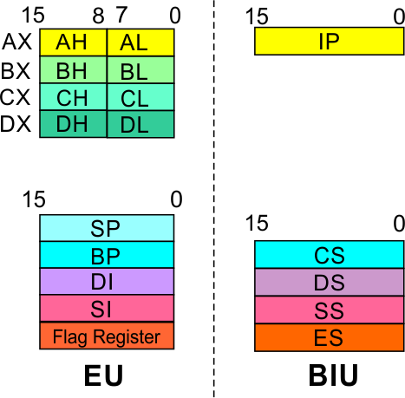

8086 Microprocessor
Architecture
Bus Interface Unit (BIU)
Segment
Registers
Code Segment Register
16-bit
CS contains the base or start of the current code segment; IP contains the distance or offset from this address to the next instruction byte to be fetched.
BIU computes the 20-bit physical address by logically shifting the contents of CS 4-bits to the left and then adding the 16-bit contents of IP.
That is, all instructions of a program are relative to the contents of the CS register multiplied by 16 and then offset is added provided by the IP.
80
Notes:
<number>

Slide 81
8086 Microprocessor
Architecture
Bus Interface Unit (BIU)
Segment
Registers
Data Segment Register
16-bit
Points to the current data segment; operands for most instructions are fetched from this segment.
The 16-bit contents of the Source Index (SI) or Destination Index (DI) or a 16-bit displacement are used as offset for computing the 20-bit physical address.
81
Notes:
<number>

Slide 82
8086 Microprocessor
Architecture
Bus Interface Unit (BIU)
Segment
Registers
Stack Segment Register
16-bit
Points to the current stack.
The 20-bit physical stack address is calculated from the Stack Segment (SS) and the Stack Pointer (SP) for stack instructions such as PUSH and POP.
In based addressing mode, the 20-bit physical stack address is calculated from the Stack segment (SS) and the Base Pointer (BP).
82
Notes:
<number>

Slide 83
8086 Microprocessor
Architecture
Bus Interface Unit (BIU)
Segment
Registers
Extra Segment Register
16-bit
Points to the extra segment in which data (in excess of 64K pointed to by the DS) is stored.
String instructions use the ES and DI to determine the 20-bit physical address for the destination.
83
Notes:
<number>

Slide 84
8086 Microprocessor
Architecture
Bus Interface Unit (BIU)
Segment
Registers
Instruction Pointer
16-bit
Always points to the next instruction to be executed within the currently executing code segment.
So, this register contains the 16-bit offset address pointing to the next instruction code within the 64Kb of the code segment area.
Its content is automatically incremented as the execution of the next instruction takes place.
84
Notes:
<number>

Slide 85
8086 Microprocessor
Architecture
Bus Interface Unit (BIU)
Instruction queue
A group of First-In-First-Out (FIFO) in which up to 6 bytes of instruction code are pre fetched from the memory ahead of time.
This is done in order to speed up the execution by overlapping instruction fetch with execution.
This mechanism is known as pipelining.
85
Notes:
<number>

Slide 86
8086 Microprocessor
Architecture
Execution Unit (EU)
EU decodes and executes instructions.
A decoder in the EU control system translates instructions.
16-bit ALU for performing arithmetic and logic operation
Four general purpose registers(AX, BX, CX, DX);
Pointer registers (Stack Pointer, Base Pointer);
and
Index registers (Source Index, Destination Index) each of 16-bits
Some of the 16 bit registers can be used as two 8 bit registers as :
AX can be used as AH and AL
BX can be used as BH and BL
CX can be used as CH and CL
DX can be used as DH and DL
86
Notes:
<number>

Slide 87
8086 Microprocessor
Architecture
Execution Unit (EU)
EU
Registers
Accumulator Register (AX)
Consists of two 8-bit registers AL and AH, which can be combined together and used as a 16-bit register AX.
AL in this case contains the low order byte of the word, and AH contains the high-order byte.
The I/O instructions use the AX or AL for inputting / outputting 16 or 8 bit data to or from an I/O port.
Multiplication and Division instructions also use the AX or AL.
87
Notes:
<number>

Slide 88
8086 Microprocessor
Architecture
Execution Unit (EU)
EU
Registers
Base Register (BX)
Consists of two 8-bit registers BL and BH, which can be combined together and used as a 16-bit register BX.
BL in this case contains the low-order byte of the word, and BH contains the high-order byte.
This is the only general purpose register whose contents can be used for addressing the 8086 memory.
All memory references utilizing this register content for addressing use DS as the default segment register.
88
Notes:
<number>

Slide 89
8086 Microprocessor
Architecture
Execution Unit (EU)
EU
Registers
Counter Register (CX)
Consists of two 8-bit registers CL and CH, which can be combined together and used as a 16-bit register CX.
When combined, CL register contains the low order byte of the word, and CH contains the high-order byte.
Instructions such as SHIFT, ROTATE and LOOP use the contents of CX as a counter.
Example:
The instruction LOOP START automatically decrements CX by 1 without affecting flags and will check if [CX] = 0.
If it is zero, 8086 executes the next instruction; otherwise the 8086 branches to the label START.
89
Notes:
<number>

Slide 90
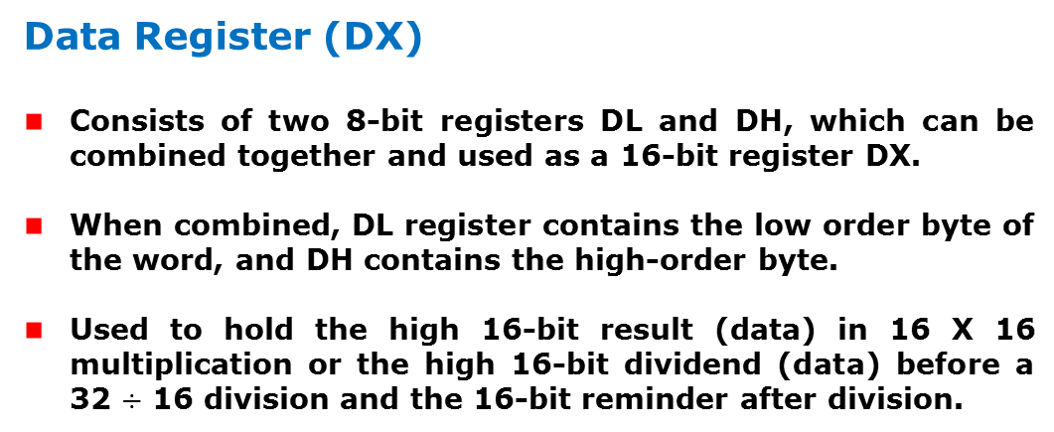
8086 Microprocessor
Architecture
Execution Unit (EU)
EU
Registers
90
Notes:
<number>

Slide 91
8086 Microprocessor
Architecture
Execution Unit (EU)
EU
Registers
Stack Pointer (SP) and Base Pointer (BP)
SP and BP are used to access data in the stack segment.
SP is used as an offset from the current SS during execution of instructions that involve the stack segment in the external memory.
SP contents are automatically updated (incremented/ decremented) due to execution of a POP or PUSH instruction.
BP contains an offset address in the current SS, which is used by instructions utilizing the based addressing mode.
91
Notes:
<number>

Slide 92
8086 Microprocessor
Architecture
Execution Unit (EU)
EU
Registers
Source Index (SI) and Destination Index (DI)
Used in indexed addressing.
Instructions that process data strings use the SI and DI registers together with DS and ES respectively in order to distinguish between the source and destination addresses.
92
Notes:
<number>

Slide 93
8086 Microprocessor
Architecture
Execution Unit (EU)
EU
Registers
Source Index (SI) and Destination Index (DI)
Used in indexed addressing.
Instructions that process data strings use the SI and DI registers together with DS and ES respectively in order to distinguish between the source and destination addresses.
93
Notes:
<number>

Slide 94
8086 Microprocessor
Architecture
Execution Unit (EU)
Auxiliary Carry Flag
This is set, if there is a carry from the lowest nibble, i.e, bit three during addition, or borrow for the lowest nibble, i.e, bit three, during subtraction.
Carry Flag
This flag is set, when there is a carry out of MSB in case of addition or a borrow in case of subtraction.
Flag Register
Sign Flag
This flag is set, when the result of any computation is negative
Zero Flag
This flag is set, if the result of the computation or comparison performed by an instruction is zero
Parity Flag
This flag is set to 1, if the lower byte of the result contains even number of 1’s ; for odd number of 1’s set to zero.
15 | 14 | 13 | 12 | 11 | 10 | 9 | 8 | 7 | 6 | 5 | 4 | 3 | 2 | 1 | 0
 |  |  |  | OF | DF | IF | TF | SF | ZF |  | AF |  | PF |  | CF
Over flow Flag
This flag is set, if an overflow occurs, i.e, if the result of a signed operation is large enough to accommodate in a destination register. The result is of more than 7-bits in size in case of 8-bit signed operation and more than 15-bits in size in case of 16-bit sign operations, then the overflow will be set.
Trap Flag
If this flag is set, the processor enters the single step execution mode by generating internal interrupts after the execution of each instruction
Direction Flag
This is used by string manipulation instructions. If this flag bit is ‘0’, the string is processed beginning from the lowest address to the highest address, i.e., auto incrementing mode. Otherwise, the string is processed from the highest address towards the lowest address, i.e., auto incrementing mode.
Interrupt Flag
Causes the 8086 to recognize external mask interrupts; clearing IF disables these interrupts.
94
Notes:
<number>

Slide 95
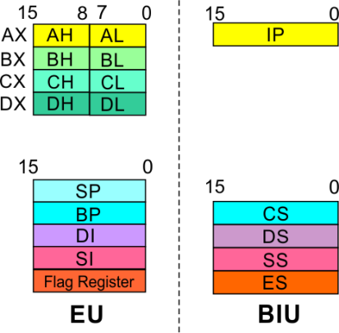
8086 Microprocessor
Architecture
8086 registers categorized groups
15 | 14 | 13 | 12 | 11 | 10 | 9 | 8 | 7 | 6 | 5 | 4 | 3 | 2 | 1 | 0
 |  |  |  | OF | DF | IF | TF | SF | ZF |  | AF |  | PF |  | CF
Sl.No. | Type | Register width | Name of register
1 | General purpose register | 16 bit | AX, BX, CX, DX
 |  | 8 bit | AL, AH, BL, BH, CL, CH, DL, DH
2 | Pointer register | 16 bit | SP, BP
3 | Index register | 16 bit | SI, DI
4 | Instruction Pointer | 16 bit | IP
5 | Segment register | 16 bit | CS, DS, SS, ES
6 | Flag (PSW) | 16 bit | Flag register
94
Notes:
<number>

Slide 96
8086 Microprocessor
Architecture
Registers and Special Functions
Register | Name of the Register | Special Function
AX | 16-bit Accumulator | Stores the 16-bit results of arithmetic and logic operations
AL | 8-bit Accumulator | Stores the 8-bit results of arithmetic and logic operations
BX | Base register | Used to hold base value in base addressing mode to access memory data
CX | Count Register | Used to hold the count value in SHIFT, ROTATE and LOOP instructions
DX | Data Register | Used to hold data for multiplication and division operations
SP | Stack Pointer | Used to hold the offset address of top stack memory
BP | Base Pointer | Used to hold the base value in base addressing using SS register to access data from stack memory
SI | Source Index | Used to hold index value of source operand (data) for string instructions
DI | Data Index | Used to hold the index value of destination operand (data) for string operations
95
Notes:
<number>

Slide 97
ADDRESSING MODES & Instruction set
Notes:
<number>

Slide 98
8086 Microprocessor
Introduction
Program
A set of instructions written to solve a problem.
Instruction
Directions which a microprocessor follows to execute a task or part of a task.
Computer language
High Level
Low Level
Machine Language
Assembly Language
 Binary bits
English Alphabets
‘Mnemonics’
Assembler Mnemonics → Machine Language
97
Notes:
<number>

Slide 99
ADDRESSING MODES
Notes:
<number>

Slide 100
8086 Microprocessor
Addressing Modes
Every instruction of a program has to operate on a data.
The different ways in which a source operand is denoted in an instruction are known as addressing modes.
Register Addressing
Immediate Addressing
Direct Addressing
Register Indirect Addressing
Based Addressing
Indexed Addressing
Based Index Addressing
String Addressing
Direct I/O port Addressing
10. Indirect I/O port Addressing
11. Relative Addressing
12. Implied Addressing
Group I : Addressing modes for register and immediate data
Group II : Addressing modes for memory data
Group III : Addressing modes for I/O ports
Group IV : Relative Addressing mode
Group V : Implied Addressing mode
<number>
Notes:
<number>

Slide 101
8086 Microprocessor
Addressing Modes
Group I : Addressing modes for register and immediate data
Register Addressing
Immediate Addressing
Direct Addressing
Register Indirect Addressing
Based Addressing
Indexed Addressing
Based Index Addressing
String Addressing
Direct I/O port Addressing
10. Indirect I/O port Addressing
11. Relative Addressing
12. Implied Addressing
The instruction will specify the name of the register which holds the data to be operated by the instruction.
Example:
MOV CL, DH
The content of 8-bit register DH is moved to another 8-bit register CL
(CL) ← (DH)
<number>
Notes:
<number>

Slide 102

8086 Microprocessor
Addressing Modes
Group I : Addressing modes for register and immediate data
Register Addressing
Immediate Addressing
Direct Addressing
Register Indirect Addressing
Based Addressing
Indexed Addressing
Based Index Addressing
String Addressing
Direct I/O port Addressing
10. Indirect I/O port Addressing
11. Relative Addressing
12. Implied Addressing
In immediate addressing mode, an 8-bit or 16-bit data is specified as part of the instruction
Example:
MOV DL, 08H
The 8-bit data (08_{H}) given in the instruction is moved to DL
(DL) ← 08_{H}
MOV AX, 0A9FH
The 16-bit data (0A9F_{H}) given in the instruction is moved to AX register
(AX) ← 0A9F_{H}
<number>
Notes:
<number>

Slide 103
8086 Microprocessor
Addressing Modes : Memory Access
Offset Value (16 bits)
Segment Register (16 bits)
0 0 0 0
Adder
Physical Address (20 Bits)
<number>
Notes:
<number>

Slide 104
8086 Microprocessor
Addressing Modes : Memory Access
20 Address lines ⇒ 8086 can address up to 2²⁰ = 1M bytes of memory
However, the largest register is only 16 bits
Physical Address will have to be calculated Physical Address : Actual address of a byte in memory. i.e. the value which goes out onto the address bus.
Memory Address represented in the form – Seg : Offset (Eg - 89AB:F012)
Each time the processor wants to access memory, it takes the contents of a segment register, shifts it one hexadecimal place to the left (same as multiplying by 16₁₀), then add the required offset to form the 20- bit address
16 bytes of contiguous memory
89AB : F012 → 89AB → 89AB0 (Paragraph to byte → 89AB x 10 = 89AB0)
F012 → 0F012 (Offset is already in byte unit)
+ -------
98AC2 (The absolute address)
<number>
Notes:
<number>

Slide 105
8086 Microprocessor
Addressing Modes : Memory Access
To access memory we use these four registers: BX, SI, DI, BP
Combining these registers inside [ ] symbols, we can get different memory locations (Effective Address, EA)
Supported combinations:
[BX + SI] [BX + DI] [BP + SI] [BP + DI] | [SI] [DI] d16 (variable offset only) [BX] | [BX + SI + d8] [BX + DI + d8] [BP + SI + d8] [BP + DI + d8]
[SI + d8] [DI + d8] [BP + d8] [BX + d8] | [BX + SI + d16] [BX + DI + d16] [BP + SI + d16] [BP + DI + d16] | [SI + d16] [DI + d16] [BP + d16] [BX + d16]
BX BP | SI DI | + disp
<number>
Notes:
<number>

Slide 106
8086 Microprocessor
Addressing Modes
Group II : Addressing modes for memory data
Register Addressing
Immediate Addressing
Direct Addressing
Register Indirect Addressing
Based Addressing
Indexed Addressing
Based Index Addressing
String Addressing
Direct I/O port Addressing
10. Indirect I/O port Addressing
11. Relative Addressing
12. Implied Addressing
Here, the effective address of the memory location at which the data operand is stored is given in the instruction.
The effective address is just a 16-bit number written directly in the instruction.
Example:
MOV BX, [1354H]
MOV BL, [0400H]
The square brackets around the 1354_{H} denotes the contents of the memory location. When executed, this instruction will copy the contents of the memory location into BX register.
This addressing mode is called direct because the displacement of the operand from the segment base is specified directly in the instruction.
<number>
Notes:
<number>

Slide 107
8086 Microprocessor
Addressing Modes
Group II : Addressing modes for memory data
Register Addressing
Immediate Addressing
Direct Addressing
Register Indirect Addressing
Based Addressing
Indexed Addressing
Based Index Addressing
String Addressing
Direct I/O port Addressing
10. Indirect I/O port Addressing
11. Relative Addressing
12. Implied Addressing
In Register indirect addressing, name of the register which holds the effective address (EA) will be specified in the instruction.
Registers used to hold EA are any of the following registers:
BX, BP, DI and SI.
Content of the DS register is used for base address calculation.
Example:
MOV CX, [BX]
Operations:
EA = (BX)
BA = (DS) x 16₁₀
MA = BA + EA
(CX) ← (MA) or,
(CL) ← (MA)
(CH) ← (MA +1)
Note : Register/ memory enclosed in brackets refer to content of register/ memory
<number>
Notes:
<number>

Slide 108
8086 Microprocessor
Addressing Modes
Group II : Addressing modes for memory data
Register Addressing
Immediate Addressing
Direct Addressing
Register Indirect Addressing
Based Addressing
Indexed Addressing
Based Index Addressing
String Addressing
Direct I/O port Addressing
10. Indirect I/O port Addressing
11. Relative Addressing
12. Implied Addressing
In Based Addressing, BX or BP is used to hold the base value for effective address and a signed 8-bit or unsigned 16-bit displacement will be specified in the instruction.
In case of 8-bit displacement, it is sign extended to 16-bit before adding to the base value.
When BX holds the base value of EA, 20-bit physical address is calculated from BX and DS.
When BP holds the base value of EA, BP and SS is used.
Example:
MOV AX, [BX + 08H]
Operations:
0008_{H} ← 08_{H} (Sign extended)
EA = (BX) + 0008_{H}
BA = (DS) x 16₁₀
MA = BA + EA
(AX) ← (MA) or,
(AL) ← (MA)
(AH) ← (MA + 1)
<number>
Notes:
<number>

Slide 109
8086 Microprocessor
Addressing Modes
Group II : Addressing modes for memory data
Register Addressing
Immediate Addressing
Direct Addressing
Register Indirect Addressing
Based Addressing
Indexed Addressing
Based Index Addressing
String Addressing
Direct I/O port Addressing
10. Indirect I/O port Addressing
11. Relative Addressing
12. Implied Addressing
SI or DI register is used to hold an index value for memory data and a signed 8-bit or unsigned 16-bit displacement will be specified in the instruction.
Displacement is added to the index value in SI or DI register to obtain the EA.
In case of 8-bit displacement, it is sign extended to 16-bit before adding to the base value.
Example:
MOV CX, [SI + 0A2H]
Operations:
FFA2_{H} ← A2_{H} (Sign extended)
EA = (SI) + FFA2_{H}
BA = (DS) x 16₁₀
MA = BA + EA
(CX) ← (MA) or,
(CL) ← (MA)
(CH) ← (MA + 1)
<number>
Notes:
<number>

Slide 110
8086 Microprocessor
Addressing Modes
Group II : Addressing modes for memory data
Register Addressing
Immediate Addressing
Direct Addressing
Register Indirect Addressing
Based Addressing
Indexed Addressing
Based Index Addressing
String Addressing
Direct I/O port Addressing
10. Indirect I/O port Addressing
11. Relative Addressing
12. Implied Addressing
In Based Index Addressing, the effective address is computed from the sum of a base register (BX or BP), an index register (SI or DI) and a displacement.
Example:
MOV DX, [BX + SI + 0AH]
Operations:
000A_{H} ← 0A_{H} (Sign extended)
EA = (BX) + (SI) + 000A_{H}
BA = (DS) x 16₁₀
MA = BA + EA
(DX) ← (MA) or,
(DL) ← (MA)
(DH) ← (MA + 1)
<number>
Notes:
<number>

Slide 111
8086 Microprocessor
Addressing Modes
Group II : Addressing modes for memory data
Register Addressing
Immediate Addressing
Direct Addressing
Register Indirect Addressing
Based Addressing
Indexed Addressing
Based Index Addressing
String Addressing
Direct I/O port Addressing
10. Indirect I/O port Addressing
11. Relative Addressing
12. Implied Addressing
Employed in string operations to operate on string data.
The effective address (EA) of source data is stored in SI register and the EA of destination is stored in DI register.
Segment register for calculating base address of
source data is DS and that of the destination data is ES
Example: MOVS BYTE
Operations:
Calculation of source memory location:
EA = (SI) BA = (DS) x 16₁₀ MA = BA + EA
Calculation of destination memory location:
EA_{E} = (DI) BA_{E} = (ES) x 16₁₀ MA_{E} = BA_{E} + EA_{E}
(MAE) ← (MA)
If DF = 1, then (SI) ← (SI) – 1 and (DI) = (DI) - 1
If DF = 0, then (SI) ← (SI) +1 and (DI) = (DI) + 1
Note : Effective address of the Extra segment register
<number>
Notes:
<number>

Slide 112
8086 Microprocessor
Addressing Modes
Group III : Addressing modes for I/O ports
Register Addressing
Immediate Addressing
Direct Addressing
Register Indirect Addressing
Based Addressing
Indexed Addressing
Based Index Addressing
String Addressing
Direct I/O port Addressing
10. Indirect I/O port Addressing
11. Relative Addressing
12. Implied Addressing
These addressing modes are used to access data from standard I/O mapped devices or ports.
In direct port addressing mode, an 8-bit port address is directly specified in the instruction.
Example: IN AL, [09H]
Operations: PORT_{addr} = 09_{H}
(AL) ← (PORT)
Content of port with address 09_{H} is moved to AL register
In indirect port addressing mode, the instruction will specify the name of the register which holds the port address. In 8086, the 16-bit port address is stored in the DX register.
Example: OUT [DX], AX
Operations: PORT_{addr} = (DX)
(PORT) ← (AX)
Content of AX is moved to port whose address is specified by DX register.
<number>
Notes:
<number>

Slide 113
8086 Microprocessor
Addressing Modes
Group IV : Relative Addressing mode
Register Addressing
Immediate Addressing
Direct Addressing
Register Indirect Addressing
Based Addressing
Indexed Addressing
Based Index Addressing
String Addressing
Direct I/O port Addressing
10. Indirect I/O port Addressing
11. Relative Addressing
12. Implied Addressing
In this addressing mode, the effective address of a program instruction is specified relative to Instruction Pointer (IP) by an 8-bit signed displacement.
Example: JZ 0AH
Operations:
000A_{H} ← 0A_{H} (sign extend)
If ZF = 1, then
EA = (IP) + 000A_{H}
BA = (CS) x 16₁₀
MA = BA + EA
If ZF = 1, then the program control jumps to new address calculated above.
If ZF = 0, then next instruction of the program is executed.
<number>
Notes:
<number>

Slide 114
8086 Microprocessor
Addressing Modes
Group IV : Implied Addressing mode
Register Addressing
Immediate Addressing
Direct Addressing
Register Indirect Addressing
Based Addressing
Indexed Addressing
Based Index Addressing
String Addressing
Direct I/O port Addressing
10. Indirect I/O port Addressing
11. Relative Addressing
12. Implied Addressing
Instructions using this mode have no operands. The instruction itself will specify the data to be operated by the instruction.
Example: CLC
This clears the carry flag to zero.
<number>
Notes:
<number>

Slide 115
INSTRUCTION SET
Notes:
<number>

Slide 116
8086 Microprocessor
Instruction Set
8086 supports 6 types of instructions.
Data Transfer Instructions
Arithmetic Instructions
Logical Instructions
String manipulation Instructions
Process Control Instructions
Control Transfer Instructions
<number>
Notes:
<number>

Slide 117
8086 Microprocessor
Instruction Set
1. Data Transfer Instructions
Instructions that are used to transfer data/ address in to registers, memory locations and I/O ports.
Generally involve two operands: Source operand and Destination operand of the same size.
Source: Register or a memory location or an immediate data
Destination : Register or a memory location.
The size should be a either a byte or a word.
A 8-bit data can only be moved to 8-bit register/ memory and a 16-bit data can be moved to 16-bit register/ memory.
<number>
Notes:
<number>

Slide 118
8086 Microprocessor
Instruction Set
1. Data Transfer Instructions
Mnemonics: MOV, XCHG, PUSH, POP, IN, OUT …
MOV reg2/ mem, reg1/ mem MOV reg2, reg1 MOV mem, reg1 MOV reg2, mem | (reg2) ← (reg1) (mem) ← (reg1) (reg2) ← (mem)
MOV reg/ mem, data MOV reg, data MOV mem, data | (reg) ← data (mem) ← data
XCHG reg2/ mem, reg1 XCHG reg2, reg1 XCHG mem, reg1 | (reg2) ↔ (reg1) (mem) ↔ (reg1)
<number>
Notes:
<number>

Slide 119
8086 Microprocessor
Instruction Set
1. Data Transfer Instructions
Mnemonics: MOV, XCHG, PUSH, POP, IN, OUT …
PUSH reg16/ mem PUSH reg16 PUSH mem | (SP) ← (SP) – 2 MA _{S} = (SS) x 16₁₀ + SP (MA _{S} ; MA _{S} + 1) ← (reg16) (SP) ← (SP) – 2 MA _{S} = (SS) x 16₁₀ + SP (MA _{S} ; MA _{S} + 1) ← (mem)
POP reg16/ mem POP reg16 POP mem | MA _{S} = (SS) x 16₁₀ + SP (reg16) ← (MA _{S} ; MA _{S} + 1) (SP) ← (SP) + 2 MA _{S} = (SS) x 16₁₀ + SP (mem) ← (MA _{S} ; MA _{S} + 1) (SP) ← (SP) + 2
<number>
Notes:
<number>

Slide 120
8086 Microprocessor
Instruction Set
1. Data Transfer Instructions
Mnemonics: MOV, XCHG, PUSH, POP, IN, OUT …
IN A, [DX] IN AL, [DX] IN AX, [DX] | PORT_{addr} = (DX) (AL) ← (PORT) PORT_{addr} = (DX) (AX) ← (PORT)
IN A, addr8 IN AL, addr8 IN AX, addr8 | (AL) ← (addr8) (AX) ← (addr8)
OUT [DX], A OUT [DX], AL OUT [DX], AX | PORT_{addr} = (DX) (PORT) ← (AL) PORT_{addr} = (DX) (PORT) ← (AX)
OUT addr8, A OUT addr8, AL OUT addr8, AX | (addr8) ← (AL) (addr8) ← (AX)
<number>
Notes:
<number>

Slide 121
8086 Microprocessor
Instruction Set
2. Arithmetic Instructions
Mnemonics: ADD, ADC, SUB, SBB, INC, DEC, MUL, DIV, CMP…
ADD reg2/ mem, reg1/mem ADC reg2, reg1 ADC reg2, mem ADC mem, reg1 | (reg2) ← (reg1) + (reg2) (reg2) ← (reg2) + (mem) (mem) ← (mem)+(reg1)
ADD reg/mem, data ADD reg, data ADD mem, data | (reg) ← (reg)+ data (mem) ← (mem)+data
ADD A, data ADD AL, data8 ADD AX, data16 | (AL) ← (AL) + data8 (AX) ← (AX) +data16
<number>
Notes:
<number>

Slide 122
8086 Microprocessor
Instruction Set
2. Arithmetic Instructions
Mnemonics: ADD, ADC, SUB, SBB, INC, DEC, MUL, DIV, CMP…
ADC reg2/ mem, reg1/mem ADC reg2, reg1 ADC reg2, mem ADC mem, reg1 | (reg2) ← (reg1) + (reg2)+CF (reg2) ← (reg2) + (mem)+CF (mem) ← (mem)+(reg1)+CF
ADC reg/mem, data ADC reg, data ADC mem, data | (reg) ← (reg)+ data+CF (mem) ← (mem)+data+CF
ADC A, data ADC AL, data8 ADC AX, data16 | (AL) ← (AL) + data8+CF (AX) ← (AX) +data16+CF
<number>
Notes:
<number>

Slide 123
8086 Microprocessor
Instruction Set
2. Arithmetic Instructions
Mnemonics: ADD, ADC, SUB, SBB, INC, DEC, MUL, DIV, CMP…
SUB reg2/ mem, reg1/mem SUB reg2, reg1 SUB reg2, mem SUB mem, reg1 | (reg2) ← (reg1) - (reg2) (reg2) ← (reg2) - (mem) (mem) ← (mem) - (reg1)
SUB reg/mem, data SUB reg, data SUB mem, data | (reg) ← (reg) - data (mem) ← (mem) - data
SUB A, data SUB AL, data8 SUB AX, data16 | (AL) ← (AL) - data8 (AX) ← (AX) - data16
<number>
Notes:
<number>

Slide 124
8086 Microprocessor
Instruction Set
2. Arithmetic Instructions
Mnemonics: ADD, ADC, SUB, SBB, INC, DEC, MUL, DIV, CMP…
SBB reg2/ mem, reg1/mem SBB reg2, reg1 SBB reg2, mem SBB mem, reg1 | (reg2) ← (reg1) - (reg2) - CF (reg2) ← (reg2) - (mem)- CF (mem) ← (mem) - (reg1) –CF
SBB reg/mem, data SBB reg, data SBB mem, data | (reg) ← (reg) – data - CF (mem) ← (mem) - data - CF
SBB A, data SBB AL, data8 SBB AX, data16 | (AL) ← (AL) - data8 - CF (AX) ← (AX) - data16 - CF
<number>
Notes:
<number>

Slide 125
8086 Microprocessor
Instruction Set
2. Arithmetic Instructions
Mnemonics: ADD, ADC, SUB, SBB, INC, DEC, MUL, DIV, CMP…
INC reg/ mem INC reg8 INC reg16 INC mem | (reg8) ← (reg8) + 1 (reg16) ← (reg16) + 1 (mem) ← (mem) + 1
DEC reg/ mem DEC reg8 DEC reg16 DEC mem | (reg8) ← (reg8) - 1 (reg16) ← (reg16) - 1 (mem) ← (mem) - 1
<number>
Notes:
<number>

Slide 126
8086 Microprocessor
Instruction Set
2. Arithmetic Instructions
Mnemonics: ADD, ADC, SUB, SBB, INC, DEC, MUL, DIV, CMP…
MUL reg/ mem MUL reg MUL mem | For byte : (AX) ← (AL) x (reg8) For word : (DX)(AX) ← (AX) x (reg16) For byte : (AX) ← (AL) x (mem8) For word : (DX)(AX) ← (AX) x (mem16)
IMUL reg/ mem IMUL reg IMUL mem | For byte : (AX) ← (AL) x (reg8) For word : (DX)(AX) ← (AX) x (reg16) For byte : (AX) ← (AX) x (mem8) For word : (DX)(AX) ← (AX) x (mem16)
<number>
Notes:
<number>

Slide 127
8086 Microprocessor
Instruction Set
2. Arithmetic Instructions
Mnemonics: ADD, ADC, SUB, SBB, INC, DEC, MUL, DIV, CMP…
DIV reg/ mem DIV reg DIV mem | For 16-bit :- 8-bit : (AL) ← (AX) :- (reg8) Quotient (AH) ← (AX) MOD(reg8) Remainder For 32-bit :- 16-bit : (AX) ← (DX)(AX) :- (reg16) Quotient (DX) ← (DX)(AX) MOD(reg16) Remainder For 16-bit :- 8-bit : (AL) ← (AX) :- (mem8) Quotient (AH) ← (AX) MOD(mem8) Remainder For 32-bit :- 16-bit : (AX) ← (DX)(AX) :- (mem16) Quotient (DX) ← (DX)(AX) MOD(mem16) Remainder
<number>
Notes:
<number>

Slide 128
8086 Microprocessor
Instruction Set
2. Arithmetic Instructions
Mnemonics: ADD, ADC, SUB, SBB, INC, DEC, MUL, DIV, CMP…
IDIV reg/ mem IDIV reg IDIV mem | For 16-bit :- 8-bit : (AL) ← (AX) :- (reg8) Quotient (AH) ← (AX) MOD(reg8) Remainder For 32-bit :- 16-bit : (AX) ← (DX)(AX) :- (reg16) Quotient (DX) ← (DX)(AX) MOD(reg16) Remainder For 16-bit :- 8-bit : (AL) ← (AX) :- (mem8) Quotient (AH) ← (AX) MOD(mem8) Remainder For 32-bit :- 16-bit : (AX) ← (DX)(AX) :- (mem16) Quotient (DX) ← (DX)(AX) MOD(mem16) Remainder
<number>
Notes:
<number>

Slide 129
8086 Microprocessor
Instruction Set
2. Arithmetic Instructions
Mnemonics: ADD, ADC, SUB, SBB, INC, DEC, MUL, DIV, CMP…
CMP reg2/mem, reg1/ mem CMP reg2, reg1 CMP reg2, mem CMP mem, reg1 | Modify flags ← (reg2) – (reg1) If (reg2) > (reg1) then CF=0, ZF=0, SF=0 If (reg2) < (reg1) then CF=1, ZF=0, SF=1 If (reg2) = (reg1) then CF=0, ZF=1, SF=0 Modify flags ← (reg2) – (mem) If (reg2) > (mem) then CF=0, ZF=0, SF=0 If (reg2) < (mem) then CF=1, ZF=0, SF=1 If (reg2) = (mem) then CF=0, ZF=1, SF=0 Modify flags ← (mem) – (reg1) If (mem) > (reg1) then CF=0, ZF=0, SF=0 If (mem) < (reg1) then CF=1, ZF=0, SF=1 If (mem) = (reg1) then CF=0, ZF=1, SF=0
<number>
Notes:
<number>

Slide 130
8086 Microprocessor
Instruction Set
2. Arithmetic Instructions
Mnemonics: ADD, ADC, SUB, SBB, INC, DEC, MUL, DIV, CMP…
CMP reg/mem, data CMP reg, data CMP mem, data | Modify flags ← (reg) – (data) If (reg) > data then CF=0, ZF=0, SF=0 If (reg) < data then CF=1, ZF=0, SF=1 If (reg) = data then CF=0, ZF=1, SF=0 Modify flags ← (mem) – (mem) If (mem) > data then CF=0, ZF=0, SF=0 If (mem) < data then CF=1, ZF=0, SF=1 If (mem) = data then CF=0, ZF=1, SF=0
<number>
Notes:
<number>

Slide 131
8086 Microprocessor
Instruction Set
2. Arithmetic Instructions
Mnemonics: ADD, ADC, SUB, SBB, INC, DEC, MUL, DIV, CMP…
CMP A, data CMP AL, data8 CMP AX, data16 | Modify flags ← (AL) – data8 If (AL) > data8 then CF=0, ZF=0, SF=0 If (AL) < data8 then CF=1, ZF=0, SF=1 If (AL) = data8 then CF=0, ZF=1, SF=0 Modify flags ← (AX) – data16 If (AX) > data16 then CF=0, ZF=0, SF=0 If (mem) < data16 then CF=1, ZF=0, SF=1 If (mem) = data16 then CF=0, ZF=1, SF=0
<number>
Notes:
<number>

Slide 132
8086 Microprocessor
Instruction Set
3. Logical Instructions
Mnemonics: AND, OR, XOR, TEST, SHR, SHL, RCR, RCL …
<number>
Notes:
<number>

Slide 133
8086 Microprocessor
Instruction Set
3. Logical Instructions
Mnemonics: AND, OR, XOR, TEST, SHR, SHL, RCR, RCL …
<number>
Notes:
<number>

Slide 134
8086 Microprocessor
Instruction Set
3. Logical Instructions
Mnemonics: AND, OR, XOR, TEST, SHR, SHL, RCR, RCL …
<number>
Notes:
<number>

Slide 135
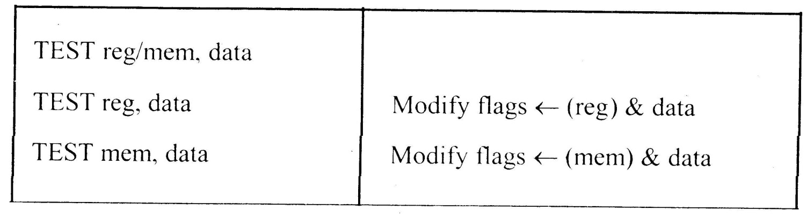
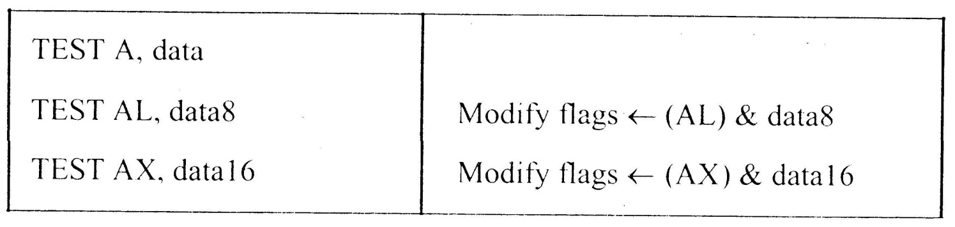
8086 Microprocessor
Instruction Set
3. Logical Instructions
Mnemonics: AND, OR, XOR, TEST, SHR, SHL, RCR, RCL …
<number>
Notes:
<number>

Slide 136
8086 Microprocessor
Instruction Set
3. Logical Instructions
Mnemonics: AND, OR, XOR, TEST, SHR, SHL, RCR, RCL …
<number>
Notes:
<number>

Slide 137
8086 Microprocessor
Instruction Set
3. Logical Instructions
Mnemonics: AND, OR, XOR, TEST, SHR, SHL, RCR, RCL …
<number>
Notes:
<number>

Slide 138
8086 Microprocessor
Instruction Set
3. Logical Instructions
Mnemonics: AND, OR, XOR, TEST, SHR, SHL, RCR, RCL …
<number>
Notes:
<number>

Slide 139
8086 Microprocessor
Instruction Set
3. Logical Instructions
Mnemonics: AND, OR, XOR, TEST, SHR, SHL, RCR, RCL …
<number>
Notes:
<number>

Slide 140
8086 Microprocessor
Instruction Set
4. String Manipulation Instructions
String : Sequence of bytes or words
8086 instruction set includes instruction for string movement, comparison, scan, load and store.
REP instruction prefix : used to repeat execution of string instructions
String instructions end with S or SB or SW. S represents string, SB string byte and SW string word.
Offset or effective address of the source operand is stored in SI register and that of the destination operand is stored in DI register.
Depending on the status of DF, SI and DI registers are automatically updated.
DF = 0 ⇒ SI and DI are incremented by 1 for byte and 2 for word.
DF = 1 ⇒ SI and DI are decremented by 1 for byte and 2 for word.
<number>
Notes:
<number>

Slide 141
8086 Microprocessor
Instruction Set
4. String Manipulation Instructions
Mnemonics: REP, MOVS, CMPS, SCAS, LODS, STOS
REP REPZ/ REPE (Repeat CMPS or SCAS until ZF = 0) REPNZ/ REPNE (Repeat CMPS or SCAS until ZF = 1) | While CX ≠ 0 and ZF = 1, repeat execution of string instruction and (CX) ← (CX) – 1 While CX ≠ 0 and ZF = 0, repeat execution of string instruction and (CX) ← (CX) - 1
<number>
Notes:
<number>

Slide 142
8086 Microprocessor
Instruction Set
4. String Manipulation Instructions
Mnemonics: REP, MOVS, CMPS, SCAS, LODS, STOS
MOVS MOVSB MOVSW | MA = (DS) x 16₁₀ + (SI) MA_{E} = (ES) x 16₁₀ + (DI) (MA_{E}) ← (MA) If DF = 0, then (DI) ← (DI) + 1; (SI) ← (SI) + 1 If DF = 1, then (DI) ← (DI) - 1; (SI) ← (SI) - 1 MA = (DS) x 16₁₀ + (SI) MA_{E} = (ES) x 16₁₀ + (DI) (MA_{E} ; MA_{E} + 1) ← (MA; MA + 1) If DF = 0, then (DI) ← (DI) + 2; (SI) ← (SI) + 2 If DF = 1, then (DI) ← (DI) - 2; (SI) ← (SI) - 2
<number>
Notes:
<number>

Slide 143
8086 Microprocessor
Instruction Set
4. String Manipulation Instructions
Mnemonics: REP, MOVS, CMPS, SCAS, LODS, STOS
Compare two string byte or string word
CMPS CMPSB CMPSW | MA = (DS) x 16₁₀ + (SI) MA_{E} = (ES) x 16₁₀ + (DI) Modify flags ← (MA) - (MA_{E}) If (MA) > (MA_{E}), then CF = 0; ZF = 0; SF = 0 If (MA) < (MA_{E}), then CF = 1; ZF = 0; SF = 1 If (MA) = (MA_{E}), then CF = 0; ZF = 1; SF = 0 For byte operation If DF = 0, then (DI) ← (DI) + 1; (SI) ← (SI) + 1 If DF = 1, then (DI) ← (DI) - 1; (SI) ← (SI) - 1 For word operation If DF = 0, then (DI) ← (DI) + 2; (SI) ← (SI) + 2 If DF = 1, then (DI) ← (DI) - 2; (SI) ← (SI) - 2
<number>
Notes:
<number>

Slide 144
8086 Microprocessor
Instruction Set
4. String Manipulation Instructions
Mnemonics: REP, MOVS, CMPS, SCAS, LODS, STOS
Scan (compare) a string byte or word with accumulator
SCAS SCASB SCASW | MA_{E} = (ES) x 16₁₀ + (DI) Modify flags ← (AL) - (MA_{E}) If (AL) > (MA_{E}), then CF = 0; ZF = 0; SF = 0 If (AL) < (MA_{E}), then CF = 1; ZF = 0; SF = 1 If (AL) = (MA_{E}), then CF = 0; ZF = 1; SF = 0 If DF = 0, then (DI) ← (DI) + 1 If DF = 1, then (DI) ← (DI) – 1 MA_{E} = (ES) x 16₁₀ + (DI) Modify flags ← (AL) - (MA_{E}) If (AX) > (MA_{E} ; MA_{E} + 1), then CF = 0; ZF = 0; SF = 0 If (AX) < (MA_{E} ; MA_{E} + 1), then CF = 1; ZF = 0; SF = 1 If (AX) = (MA_{E} ; MA_{E} + 1), then CF = 0; ZF = 1; SF = 0 If DF = 0, then (DI) ← (DI) + 2 If DF = 1, then (DI) ← (DI) – 2
<number>
Notes:
<number>

Slide 145
8086 Microprocessor
Instruction Set
4. String Manipulation Instructions
Mnemonics: REP, MOVS, CMPS, SCAS, LODS, STOS
Load string byte in to AL or string word in to AX
LODS LODSB LODSW | MA = (DS) x 16₁₀ + (SI) (AL) ← (MA) If DF = 0, then (SI) ← (SI) + 1 If DF = 1, then (SI) ← (SI) – 1 MA = (DS) x 16₁₀ + (SI) (AX) ← (MA ; MA + 1) If DF = 0, then (SI) ← (SI) + 2 If DF = 1, then (SI) ← (SI) – 2
<number>
Notes:
<number>

Slide 146
8086 Microprocessor
Instruction Set
4. String Manipulation Instructions
Mnemonics: REP, MOVS, CMPS, SCAS, LODS, STOS
Store byte from AL or word from AX in to string
STOS STOSB STOSW | MA_{E} = (ES) x 16₁₀ + (DI) (MA_{E}) ← (AL) If DF = 0, then (DI) ← (DI) + 1 If DF = 1, then (DI) ← (DI) – 1 MA_{E} = (ES) x 16₁₀ + (DI) (MA_{E} ; MA_{E} + 1 ) ← (AX) If DF = 0, then (DI) ← (DI) + 2 If DF = 1, then (DI) ← (DI) – 2
<number>
Notes:
<number>

Slide 147
8086 Microprocessor
Instruction Set
5. Processor Control Instructions
Mnemonics | Explanation
STC | Set CF ← 1
CLC | Clear CF ← 0
CMC | Complement carry CF ← CF/
STD | Set direction flag DF ← 1
CLD | Clear direction flag DF ← 0
STI | Set interrupt enable flag IF ← 1
CLI | Clear interrupt enable flag IF ← 0
NOP | No operation
HLT | Halt after interrupt is set
WAIT | Wait for TEST pin active
ESC opcode mem/ reg | Used to pass instruction to a coprocessor which shares the address and data bus with the 8086
LOCK | Lock bus during next instruction
<number>
Notes:
<number>

Slide 148
8086 Microprocessor
Instruction Set
6. Control Transfer Instructions
Transfer the control to a specific destination or target instruction
Do not affect flags
8086 Unconditional transfers
Mnemonics | Explanation
CALL reg/ mem/ disp16 | Call subroutine
RET | Return from subroutine
JMP reg/ mem/ disp8/ disp16 | Unconditional jump
<number>
Notes:
<number>

Slide 149
8086 Microprocessor
Instruction Set
6. Control Transfer Instructions
8086 signed conditional branch instructions
8086 unsigned conditional branch instructions
Checks flags
If conditions are true, the program control is transferred to the new memory location in the same segment by modifying the content of IP
<number>
Notes:
<number>

Slide 150
8086 Microprocessor
Instruction Set
6. Control Transfer Instructions
8086 signed conditional branch instructions
8086 unsigned conditional branch instructions
Name | Alternate name
JE disp8 Jump if equal | JZ disp8 Jump if result is 0
JNE disp8 Jump if not equal | JNZ disp8 Jump if not zero
JG disp8 Jump if greater | JNLE disp8 Jump if not less or equal
JGE disp8 Jump if greater than or equal | JNL disp8 Jump if not less
JL disp8 Jump if less than | JNGE disp8 Jump if not greater than or equal
JLE disp8 Jump if less than or equal | JNG disp8 Jump if not greater
Name | Alternate name
JE disp8 Jump if equal | JZ disp8 Jump if result is 0
JNE disp8 Jump if not equal | JNZ disp8 Jump if not zero
JA disp8 Jump if above | JNBE disp8 Jump if not below or equal
JAE disp8 Jump if above or equal | JNB disp8 Jump if not below
JB disp8 Jump if below | JNAE disp8 Jump if not above or equal
JBE disp8 Jump if below or equal | JNA disp8 Jump if not above
<number>
Notes:
<number>

Slide 151
8086 Microprocessor
Instruction Set
6. Control Transfer Instructions
8086 conditional branch instructions affecting individual flags
Mnemonics | Explanation
JC disp8 | Jump if CF = 1
JNC disp8 | Jump if CF = 0
JP disp8 | Jump if PF = 1
JNP disp8 | Jump if PF = 0
JO disp8 | Jump if OF = 1
JNO disp8 | Jump if OF = 0
JS disp8 | Jump if SF = 1
JNS disp8 | Jump if SF = 0
JZ disp8 | Jump if result is zero, i.e, Z = 1
JNZ disp8 | Jump if result is not zero, i.e, Z = 1
<number>
Notes:
<number>

Slide 152
Assembler directives
Notes:
<number>

Slide 153
8086 Microprocessor
Assemble Directives
Instructions to the Assembler regarding the program being executed.
Control the generation of machine codes and organization of the program; but no machine codes are generated for assembler directives.
Also called ‘pseudo instructions’
Used to :
› specify the start and end of a program
› attach value to variables
› allocate storage locations to input/ output data
› define start and end of segments, procedures, macros etc..
<number>
Notes:
<number>

Slide 154
8086 Microprocessor
Assemble Directives
DB
DW
SEGMENT
ENDS
ASSUME
ORG
END
EVEN
EQU
PROC
FAR
NEAR
ENDP
SHORT
MACRO
ENDM
Define Byte
Define a byte type (8-bit) variable
Reserves specific amount of memory locations to each variable
Range : 00_{H} – FF_{H} for unsigned value; 00_{H} – 7F_{H} for positive value and 80_{H} – FF_{H} for negative value
General form : variable DB value/ values
Example:
LIST DB 7FH, 42H, 35H
Three consecutive memory locations are reserved for the variable LIST and each data specified in the instruction are stored as initial value in the reserved memory location
<number>
Notes:
<number>

Slide 155
8086 Microprocessor
Assemble Directives
DB
DW
SEGMENT
ENDS
ASSUME
ORG
END
EVEN
EQU
PROC
FAR
NEAR
ENDP
SHORT
MACRO
ENDM
Define Word
Define a word type (16-bit) variable
Reserves two consecutive memory locations to each variable
Range : 0000_{H} – FFFF_{H} for unsigned value; 0000_{H} – 7FFF_{H} for positive value and 8000_{H} – FFFF_{H} for negative value
General form : variable DW value/ values
Example:
ALIST DW 6512H, 0F251H, 0CDE2H
Six consecutive memory locations are reserved for the variable ALIST and each 16-bit data specified in the instruction is stored in two consecutive memory location.
<number>
Notes:
<number>

Slide 156
8086 Microprocessor
Assemble Directives
DB
DW
SEGMENT
ENDS
ASSUME
ORG
END
EVEN
EQU
PROC
FAR
NEAR
ENDP
SHORT
MACRO
ENDM
SEGMENT : Used to indicate the beginning of a code/ data/ stack segment
ENDS : Used to indicate the end of a code/ data/ stack segment
General form:
Segnam SEGMENT … … … … … … Segnam ENDS | Program code or Data Defining Statements
User defined name of the segment
<number>
Notes:
<number>

Slide 157
8086 Microprocessor
Assemble Directives
DB
DW
SEGMENT
ENDS
ASSUME
ORG
END
EVEN
EQU
PROC
FAR
NEAR
ENDP
SHORT
MACRO
ENDM
Informs the assembler the name of the program/ data segment that should be used for a specific segment.
General form:
ASSUME segreg : segnam, .. , segreg : segnam
Segment Register
User defined name of the segment
Example:
ASSUME CS: ACODE, DS:ADATA | Tells the compiler that the instructions of the program are stored in the segment ACODE and data are stored in the segment ADATA
<number>
Notes:
<number>

Slide 158
8086 Microprocessor
Assemble Directives
DB
DW
SEGMENT
ENDS
ASSUME
ORG
END
EVEN
EQU
PROC
FAR
NEAR
ENDP
SHORT
MACRO
ENDM
ORG (Origin) is used to assign the starting address (Effective address) for a program/ data segment
END is used to terminate a program; statements after END will be ignored
EVEN : Informs the assembler to store program/ data segment starting from an even address
EQU (Equate) is used to attach a value to a variable
Examples:
ORG 1000H | Informs the assembler that the statements following ORG 1000H should be stored in memory starting with effective address 1000_{H}
LOOP EQU 10FEH | Value of variable LOOP is 10FE_{H}
_SDATA SEGMENT ORG 1200H A DB 4CH EVEN B DW 1052H _SDATA ENDS | In this data segment, effective address of memory location assigned to A will be 1200_{H} and that of B will be 1202_{H} and 1203_{H}.
<number>
Notes:
<number>

Slide 159
8086 Microprocessor
Assemble Directives
DB
DW
SEGMENT
ENDS
ASSUME
ORG
END
EVEN
EQU
PROC
ENDP
FAR
NEAR
SHORT
MACRO
ENDM
PROC Indicates the beginning of a procedure
ENDP End of procedure
FAR Intersegment call
NEAR Intrasegment call
General form
procname PROC[NEAR/ FAR] … … … RET procname ENDP | Program statements of the procedure Last statement of the procedure
User defined name of the procedure
<number>
Notes:
<number>

Slide 160
8086 Microprocessor
Assemble Directives
DB
DW
SEGMENT
ENDS
ASSUME
ORG
END
EVEN
EQU
PROC
ENDP
FAR
NEAR
SHORT
MACRO
ENDM
Examples:
ADD64 PROC NEAR … … … RET ADD64 ENDP | The subroutine/ procedure named ADD64 is declared as NEAR and so the assembler will code the CALL and RET instructions involved in this procedure as near call and return
CONVERT PROC FAR … … … RET CONVERT ENDP | The subroutine/ procedure named CONVERT is declared as FAR and so the assembler will code the CALL and RET instructions involved in this procedure as far call and return
<number>
Notes:
<number>

Slide 161
8086 Microprocessor
Assemble Directives
DB
DW
SEGMENT
ENDS
ASSUME
ORG
END
EVEN
EQU
PROC
ENDP
FAR
NEAR
SHORT
MACRO
ENDM
Reserves one memory location for 8-bit signed displacement in jump instructions
Example:
JMP SHORT AHEAD | The directive will reserve one memory location for 8-bit displacement named AHEAD
<number>
Notes:
<number>

Slide 162
8086 Microprocessor
Assemble Directives
DB
DW
SEGMENT
ENDS
ASSUME
ORG
END
EVEN
EQU
PROC
ENDP
FAR
NEAR
SHORT
MACRO
ENDM
MACRO Indicate the beginning of a macro
ENDM End of a macro
General form:
macroname MACRO[Arg1, Arg2 ...] … … … macroname ENDM | Program statements in the macro
User defined name of the macro
<number>
Notes:
<number>

